Slide 1




From
To
AndThe INTERNET
Santa Ric Erwin
Notes:
Welcome to the FORBSantas Professional Workshop
“From FOLKTALES To EMAILS: Santa & The Internet”
(CLICK)
I’m your host, Santa Ric Erwin

Slide 2
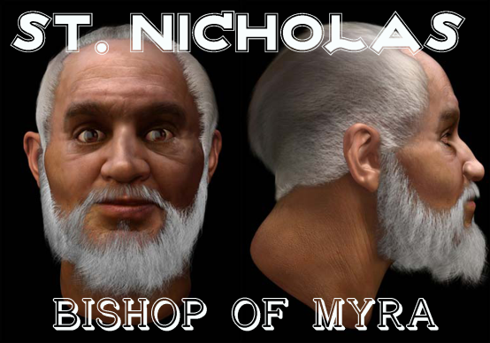


AGELESS, but not CHANGELESS
From
to
to
SANTA has ALWAYS been a product of his environment!!!
Notes:
I can think of no character in popular culture who has evolved more than SANTA CLAUS;
yet, with each new incarnation, Santa becomes more closely associated with the world’s most celebrated holiday!
And Santa is STILL evolving— the fact is, he HAS to, if a character dating from the 4th Century wants to remain relevant in the Internet Age!

Slide 3
Okay,
POP QUIZ!
Internet Era
Space Age
Yours Truly
Personal Computing
United States
Q: What Do All Five Of These Things Have In Common With One Another?
Notes:
To give us some historical perspective on the subject, here’s an impromptu trivia quiz!
What do the World-Wide Web, the Space Age, the personal computer, and the US of A all have in common with ME?
The answer?

Slide 4
Okay,
POP QUIZ!
Internet Era
Space Age
Yours Truly
Personal Computing
United States
Q: WHAT DO THESE 5 THINGS ALL HAVE IN COMMON?
A: WE’RE THE SAME AGE!!!
Notes:
Every one of them can be traced back to within ONE YEAR of the day I was born!!
Talk about living in historical times!!!

Slide 5
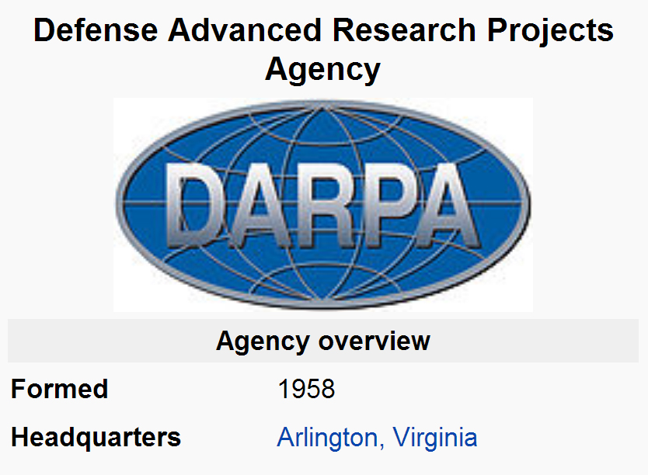
February 15, 1958
Notes:
Four weeks after Sputnik, the US military formed DARPA — which would eventually become the INTERNET...
They were tasked with guaranteeing that America would forevermore hold the lead in all things technological—
And not only did they fulfill that mandate, THEY LITERALLY CHANGED THE COURSE OF HUMAN HISTORY!!

Slide 6
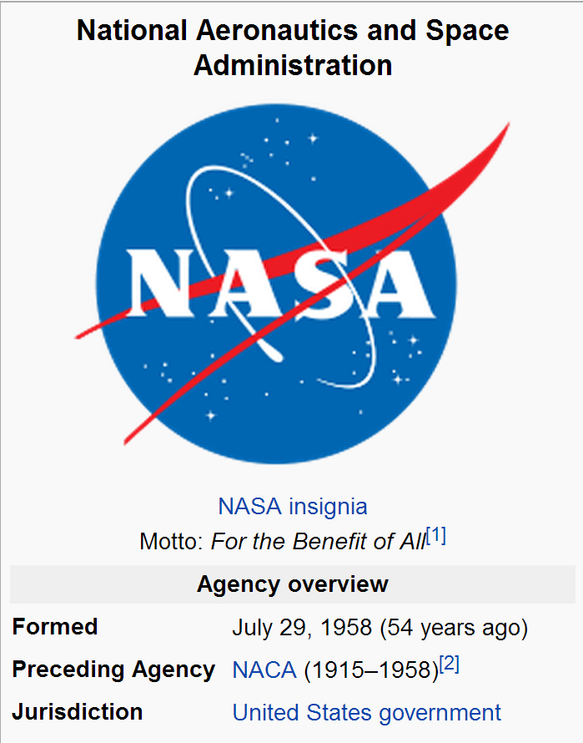
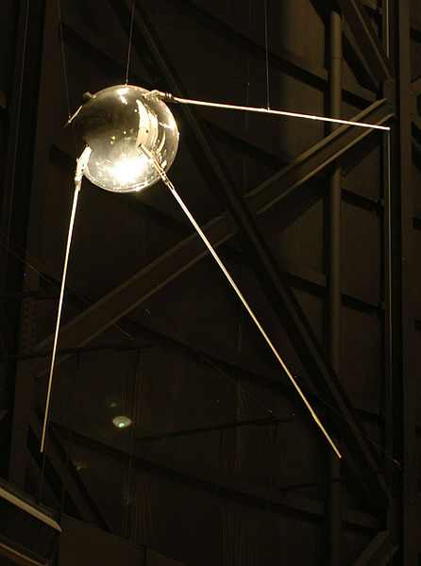
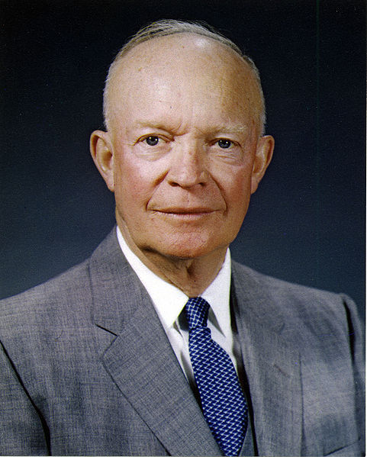
July 29, 1958
Notes:
Five months later, with Americans clamoring ever louder for a “Sputnik” of our own,
President Eisenhower signs into law the National Aeronautics & Space Act
— and the Space Race was on!
NOW: nestled chronologically in the middle of these milestones in human history, we find the most important of all:

Slide 7
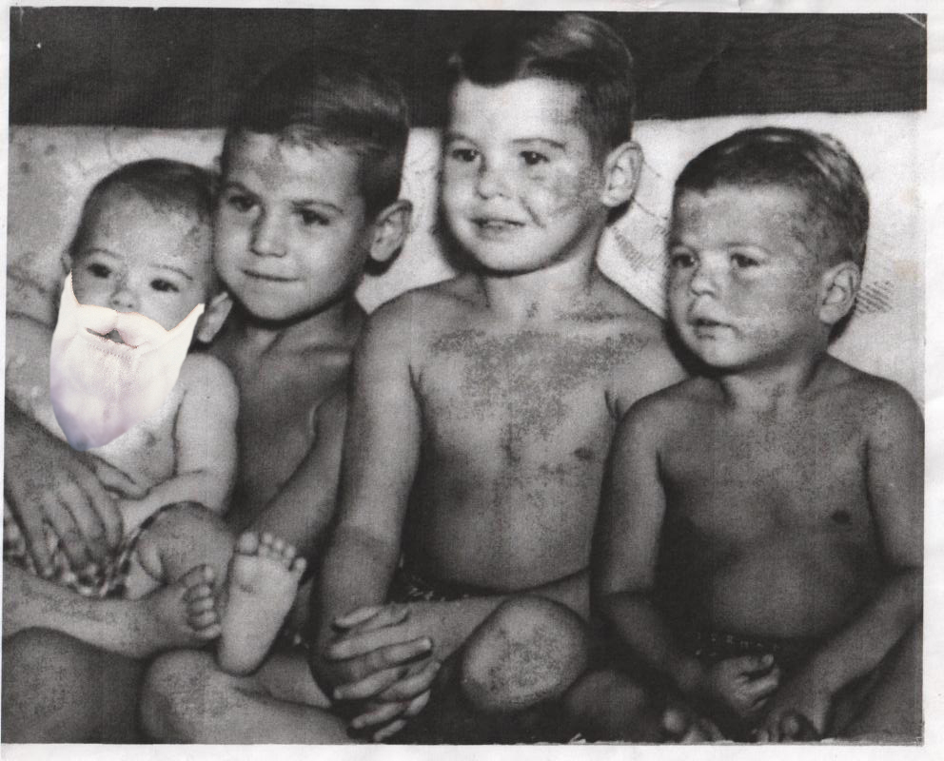
August 20, 1958
Santa Ric Erwin is born, the youngest of four boys,
in Duval County, near the city of Jacksonville, Florida
Notes:
If I’d only known how much the world was gonna change in my chubby little lifetime,
I’d have probably focused a little more on learning & a little less on the ladies...
... Then again, MAYBE NOT!!!
Moving on:

Slide 8
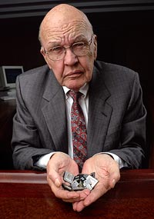
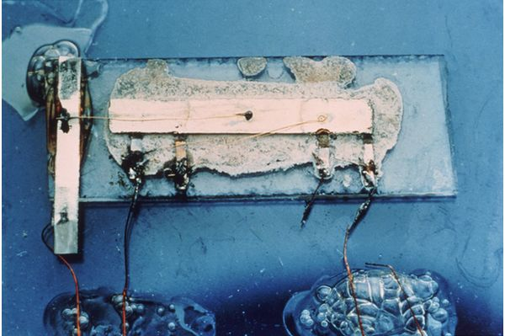
September 12, 1958
Nobel Physicist
Jack Kilby
The World’s First Integrated Circuit
Notes:
A few weeks later, Physicist Jack Kilby, under contract to Texas Instruments,
demonstrates the world’s first “Integrated Circuit”,
which leads directly to the microchip & the personal computer!
Clearly, Kilby’s discovery has proven every bit as momentous as those of other Nobel Physics Winners:
With names like Curie, Marconi, Einstein & Fermi

Slide 9
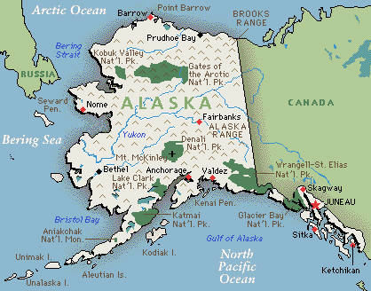
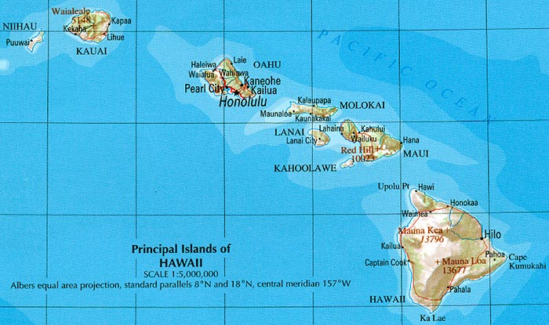


Jan 3 & Aug 21, 1959
Our 49th
& 50th
United States!!
Notes:
In the year following my birth,
Alaska & Hawaii became the 49th & 50th states—
and modern-day AMERICA was born!!

Slide 10

A Brief History Of The Internet
Notes:
We’ll be covering a lot of ground in this workshop—
so before begin discussing where we are today in the development of cyber-space,
I thought it would help to give us some perspective to take a brief look at how we got here...
This video is a few years old now, but since the HISTORY of the internet hasn’t changed in that time,
I see no need to discard this video just because of an ill-advised opening line that SERIOUSLY dates itself!
(PLAY VIDEO)
BTW: knowing that the internet can seem daunting & confusing to someone who is a bit late in joining the game,
I gladly offer this reassurance:
THE INTERNET ITSELF WILL TEACH YOU ALL YOU NEED TO KNOW
Most of the graphics used in this workshop — and ALL of the videos—were found online, using simple search terms!

Slide 11
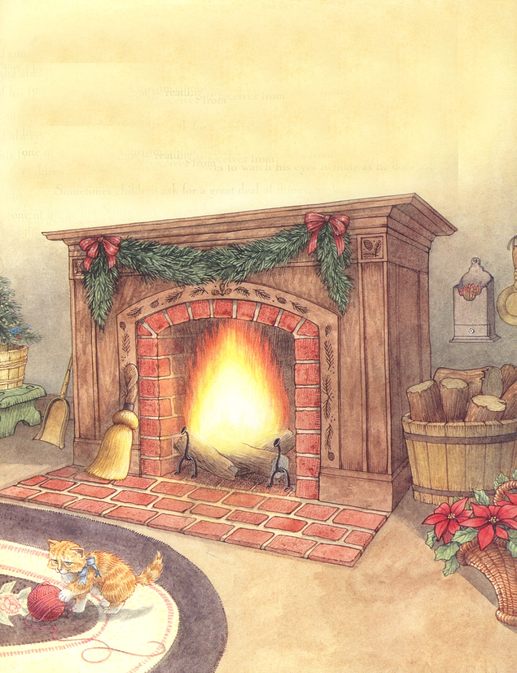

The Modern Santa’s
MUST-HAVE Accessory
A Personal Computer
That Is Connected To
The INTERNET–
WILL GROW YOUR
SANTA BUSINESS!!
Notes:
We’ll get back to the Internet in a bit—
But let’s pause here and talk about those devices that make it possible—
COMPUTERS !!
Regardless of the type of Santa you’d like to be:
An experienced Mall Santa hoping for more home visits
A “free-lancer” hoping to grow your own client list
Or one of those privileged few who can afford to donate their entire Season to charity
IT’S A FACT:
A Personal Computer
That Is Connected To
The INTERNET–
WILL GROW YOUR
SANTA BUSINESS!!

Slide 12

COMPUTERS ARE A WARE!
In fact, most
of them happen to be MANY “wares”:
HARDware
SOFTware
WETware
SHAREware
WEARware
Notes:
First, let’s talk about computing in general, using the most common terminologies today;
As you probably know, the word “computer” itself is a misnomer—
in that it actually refers to a complex interactivity of different types of systems :
Some are mechanical, like a car;
while others are digital, like a television;
but there are several categories that are simply without parallel outside of information technology...

Slide 13
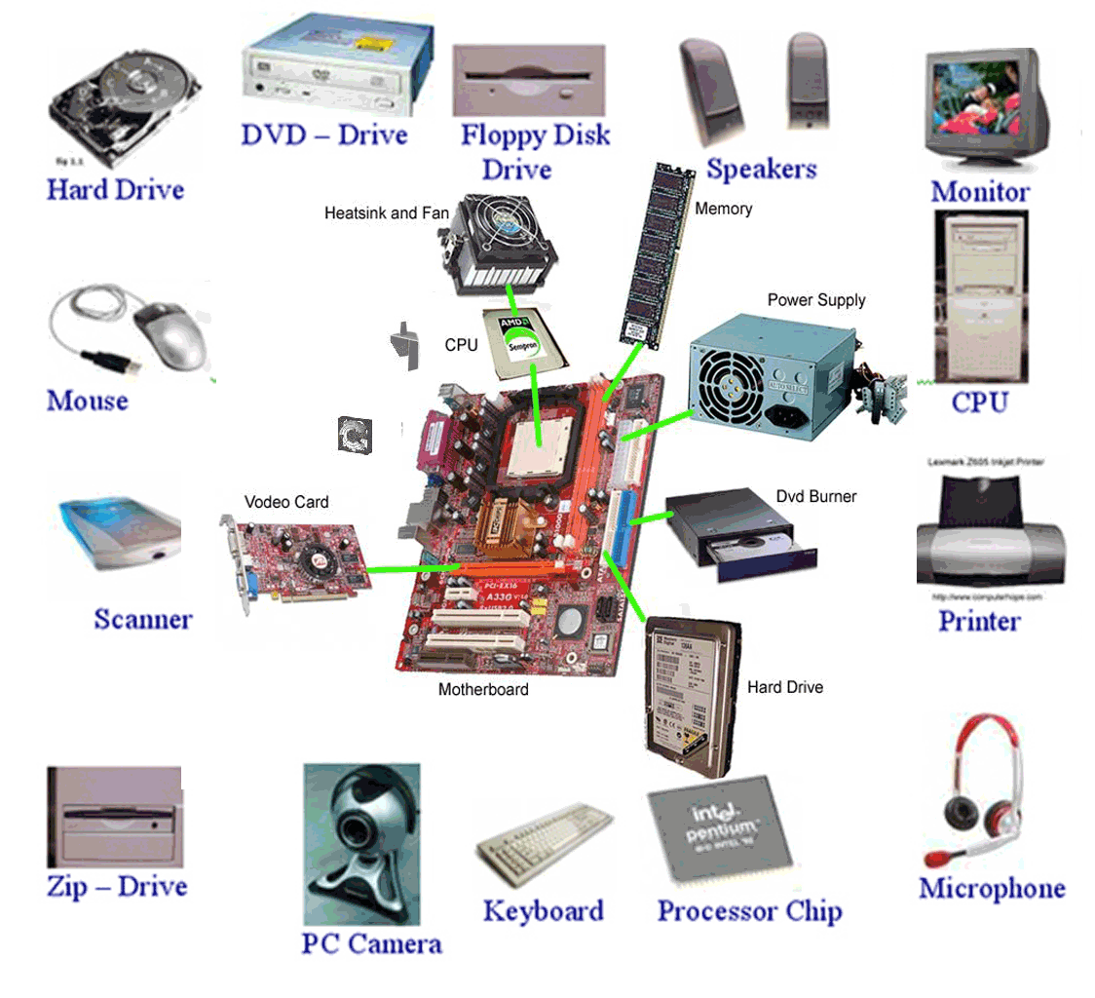
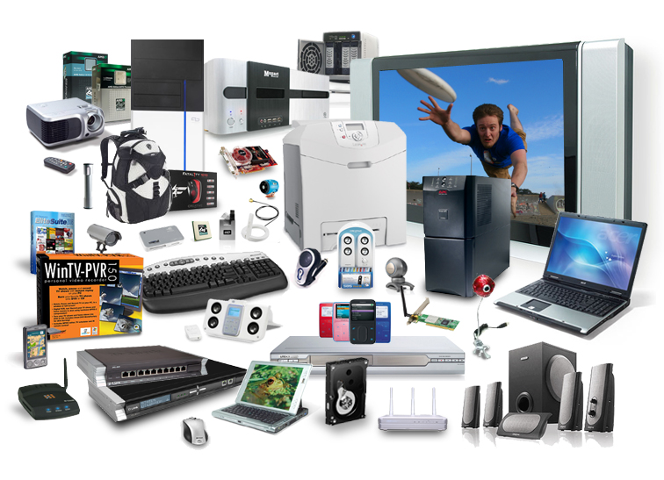

HARDWARE
The computer’s equipment & all those devices attached to it
Handling
A Growing Problem
Notes:
I won’t waste too much time here— the category itself is fairly self-explanatory, and we’ll discuss a few common options in a bit;
For now, just know that nothing works without the hardware.
Also, please remember this—
Because of the rare earths & heavy metals used in their manufacture—
properly recycling electronics components is MUCH more important than separating your drink cans & plastic bottles:
Although the quantities per device might be negligible, the cumulative affects from millions of devices retiring every day can be staggering!
The problem has gotten SO bad that retail hi-tech purchases now include a pre-paid recycling fee of several percent to help finance solutions...
Many communities also host hi-tech recycling— if only once or twice per month, and at a school or fire station...
FIND OUT WHEN AND PLEASE TAKE YOUR OLD DEVICES THERE!

Slide 14
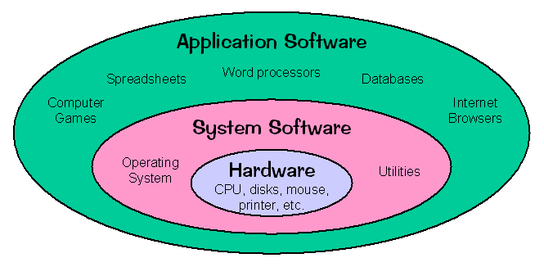

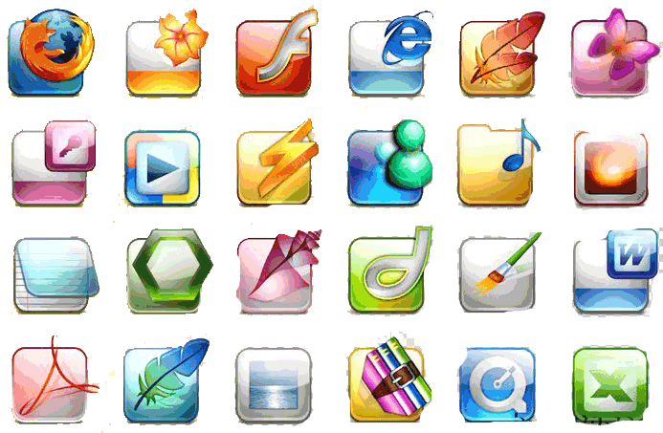
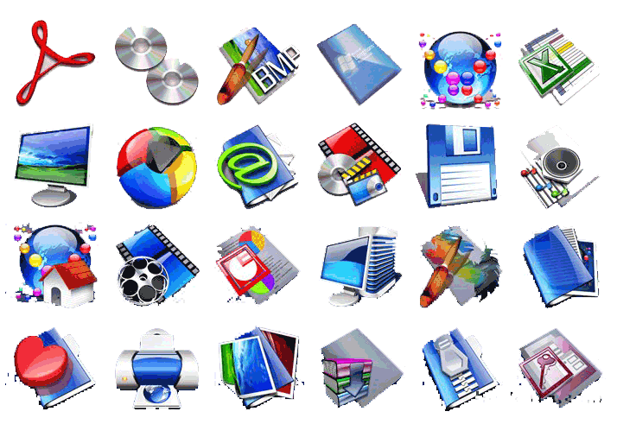
SOFTWARE
Operating Systems / Servers / Programs / Drivers / Browsers
Notes:
Again, I’m not going to waste too much time here, since we’re going to discuss a few of the more common options later;
But I would like you to take special notice of the systemic hierarchy—
At the core is the HARDWARE, on which runs the Operating System, which in turn manages all the programs & apps that we work & play with!

Slide 15
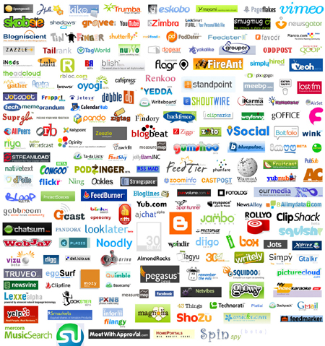
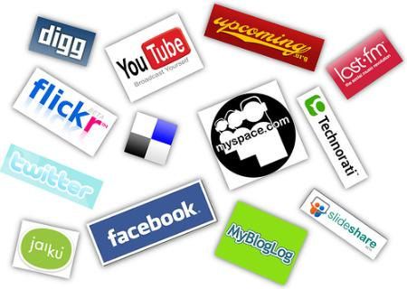
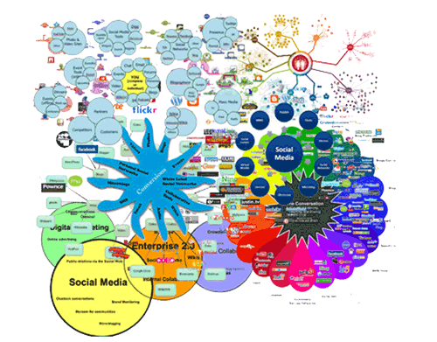
SHAREWARE
Was:
Is:
Will Be:
Notes:
For years, the term “shareware” referred to any software intended for free distribution— as opposed to retail sales.
Today, it describes a rapidly-evolving class of hardware/software hybrid technologies designed to allow any number of web-connected devices to run the same program AT THE SAME TIME---
Thus “SHARING”: Bandwidth / Processor Capacity / Database Information / Video Conferencing / Group Sharing / Remote Monitoring / Online Gaming / Design Collaborations / Real-Time Reporting / Digital Tourism —
the list goes on & on— and it even includes things like Vonage, Skype & Netflix!!!
Share-ware is driving a modern-day gold rush almost greater than everything before it, combined—
and that is financing quantum leaps in technology & research, spawning new breakthroughs at an almost-exponential rate
Again: we’ll look more at the internet later...

Slide 16
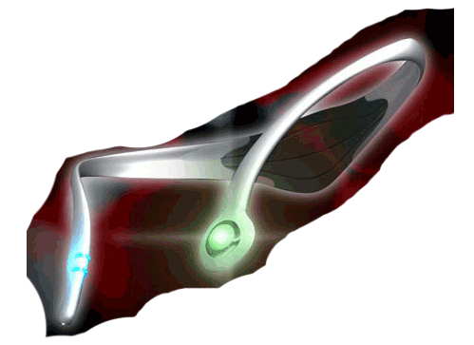
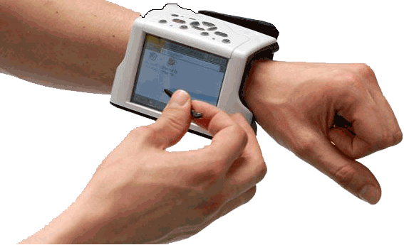
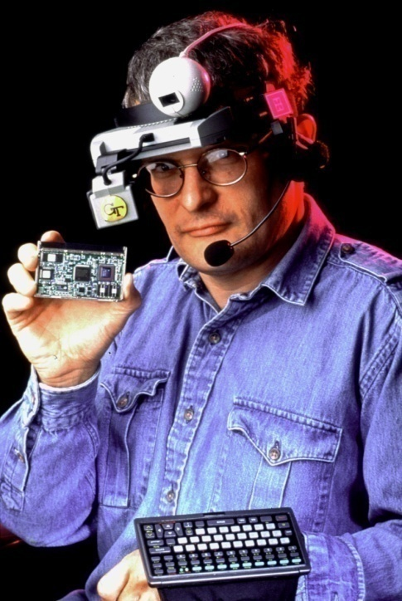

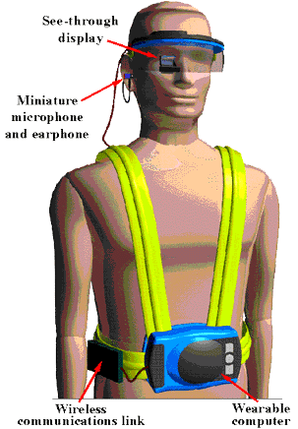
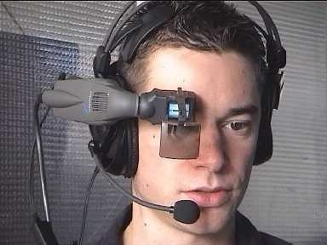
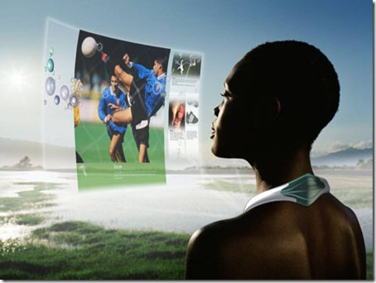

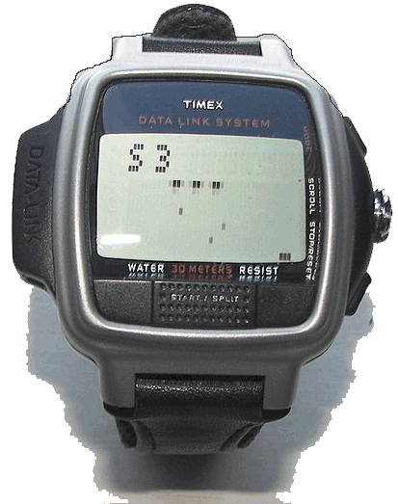
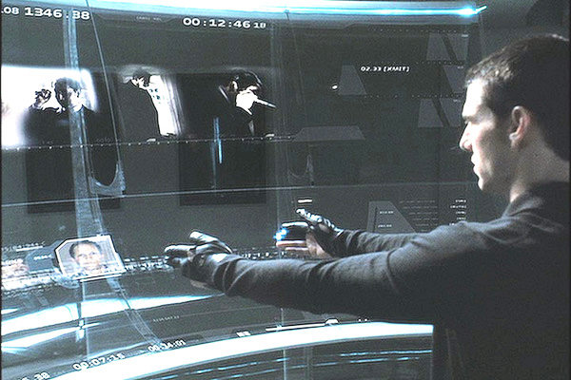
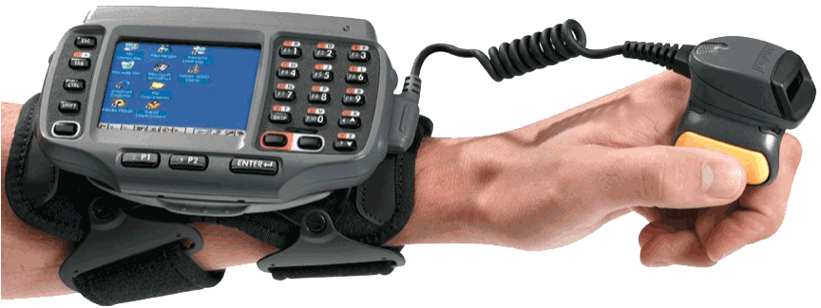

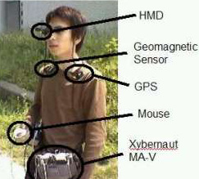
WEARWARE:
It’s WHERE We’re Going Next
Notes:
This last category is called “WEARware”; and it’s the youngest child in the technology family—
But don’t be fooled: it’s already so big that it’s more like “Baby Huey” from the Donald Duck cartoons!
Soon, your home & cell phones will merge with your home & office computers–
At the same time, they’ll be joined by your television, newspapers & the public library—
With your favorite grocery stores & retail outlets tossed in!!
In the not-too-distant future, you’ll WEAR your computer–
With its parts distributed about your person along with your clothing & jewelry…
Boy, when I remember, back when I was a kid, how incredibly futuristic Dick Tracey’s 2-way wrist-radio seemed to me...
BTW: does anybody know which movie that bottom right graphic came from?

Slide 17
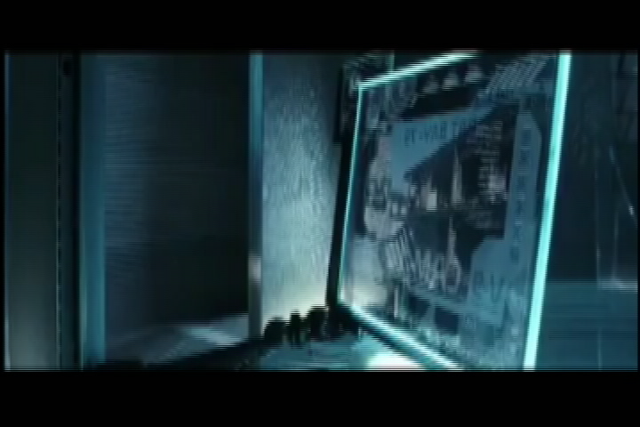
Minority Report 3D Interfacing
Notes:
(PLAY VIDEO)
That’s right: it’s Stephen Spielberg’s 2002 sci-fi thriller, “Minority Report”
and I strongly urge each of you to watch this movie— AGAIN, if you’ve seen it before!
And I’ll tell you why:
it’ll be easy for you to wrap your head around the mind-blowing technology Tom Cruise is playing around with in the film—
because, only 10 years later, MOST OF IT IS IN USE TODAY!

Slide 18
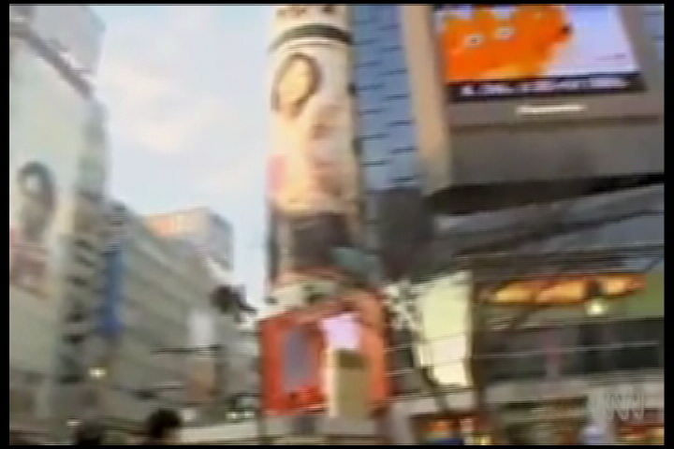
Minority Report Ads—TODAY!
Notes:
Take those public advertisements that recognize & talk to you:
(PLAY VIDEO)
Face recognition technology has been test-bedded in Tokyo subway advertising for years—
and now they’re merging with cell networks to show you personalized offers based on your actual consumer habits!
Rapid advances are also being made in the area of audio targeting— where multiple transmitters are able to “assemble” a sound
which is focused on a specific point in space, so it cannot be heard elsewhere— and it will follow a moving target!
Soon, advertisements will take the form of “conversations”— in which your responses can be facial expressions & physical gestures!

Slide 19
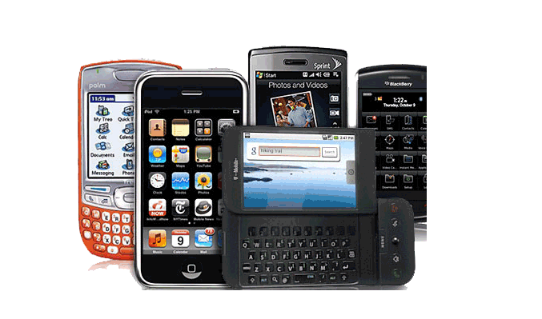
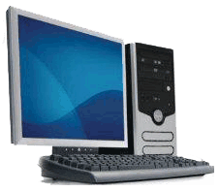

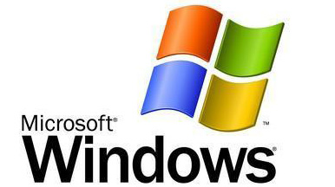


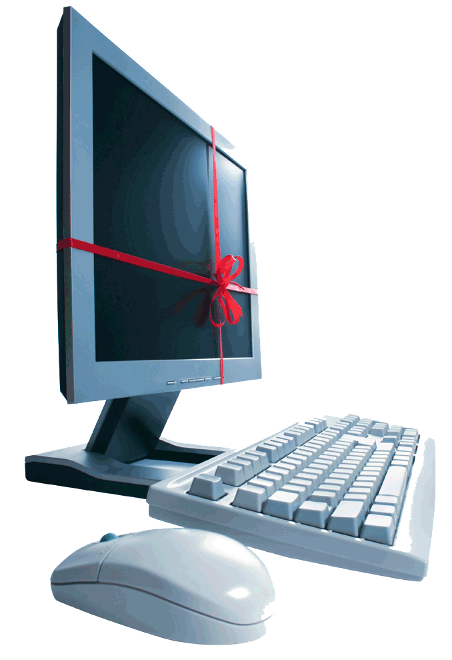

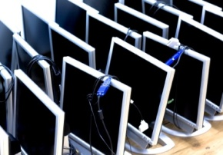



More OPTIONS, you say? OK—but be careful what you wish for:
DESKTOP | or | LAPTOP | or | MOBILE?
 | or |  | or
NEW | or | REFURB | or | USED
 | or |  | or
Notes:
Another reason computers & the internet can seem so intimidating is the fact that you’re ALWAYS being asked to choose between a variety of options—
about most of which you have little or no personal knowledge or experience!
We’ll take a few minutes to offer some pretty generic advice regarding a few of the more likely choices you’ll be faced with, early on:

Slide 20
DESKTOP | or | LAPTOP
Get a DESKTOP if you:
Get a LAPTOP if you:
Like paying less & getting more
Plan to “pop the hood” on your PC and just hot-rod the heck out of it
Work A LOT with multimedia: like audio/video/animation/web design
Don't really plan to take your PC anywhere—or if you do, don't really mind hauling all that gear around
(We’re looking at you, GAMERS…)
Simply don’t have desk space for you, the latte maker and a PC
Have an awful aversion to wires
Often wish you could take your PC outside without using a hand truck
Love your PC so much that you cannot bear to be apart from it...
Are secretly an espionage agent to whom mobility means life or death
UPGRADES & LIFESPAN : The average Laptop is replaced during its SECOND year of use, while the average Desktop (more easily upgraded) is kept for about TWICE that long…
Notes:
THIS WILL BE ONE OF YOUR FIRST MAJOR DECISIONS— let’s take a minute to discuss it...
a desktop PC is probably your best bet If you're looking to scream through multimedia downloads (think music, movies, and that massive vacation video Aunt Lucy sent before realizing it was 30 MB). Want to learn how?
Put another way, if you're looking for mega performance at a reasonable price, the desktop PC could be the right solution for you.
With a larger tower or "box," the manufacturer has a lot more space to work with and can pack in a great deal more, truly awesome, technologies.
You can also purchase multiple large hard drives and CD/DVD-ROM drives and still have space for upgrades.
You can upgrade to a greater extent with a desktop than you can with a laptop.
Things you may want to add include additional random access memory (RAM), a better video card, and one of the Newer, faster processors.
But there are several reasons the laptop is so popular!
For one thing, while they're getting smaller and sleeker, desktop PCs take up a lot more space.
For another thing, with a laptop PC you've got one power cord, and even then, only when you need to recharge;
it's a completely self-contained unit, and you don't have to deal with a separate monitor or CPU, along with their extra power cords...
Plus, most come with a built in wireless adapter so you can connect to the Internet without being leashed to the wall.
And you can add a wireless printer & other peripherals that communicates with your laptop via WiFi, or Bluetooth technology.
Theif main drawback is this: no matter where you are, or how nice the view, you don't want to be interrupted after only an hour by that terrible "low battery... doomsday approaching" warning.
A laptop is only as good as the battery that powers it!
But thanks to advancements in battery, hardware, and software technology (yes, software can drain your battery too)
today, you can get as many as five hours from some laptops— plenty of time to get things done without plugging in.

Slide 21
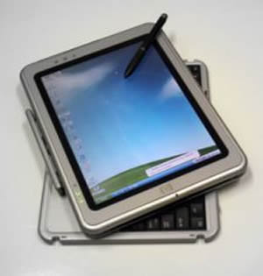
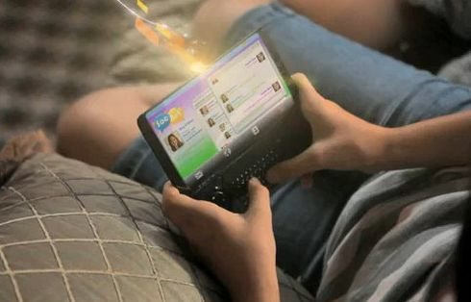
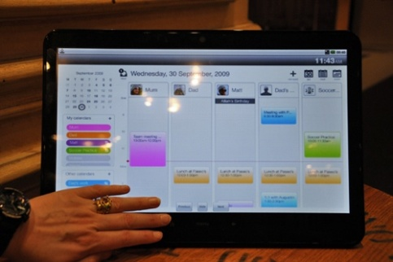
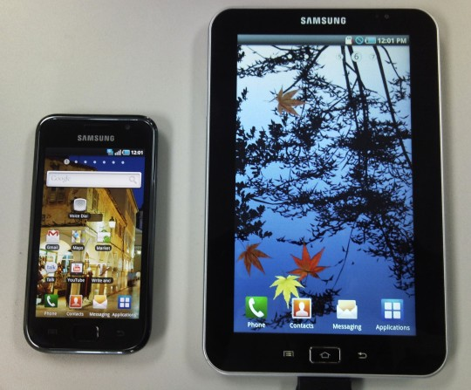

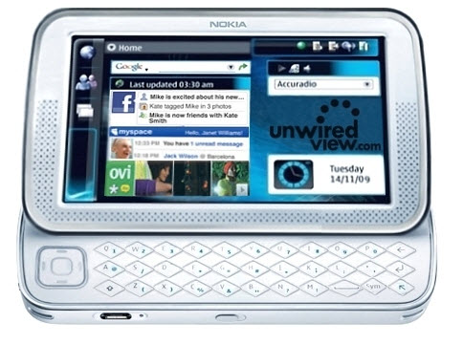
my phone is becoming my biggest hang-up
(Get it? His phone is his biggest HANG UP?
I tell you, sometimes Santa just SLEIGHS me!)
Notes:
(PLAY VIDEO)
the laptop used to be a less powerful option than a desktop PC. However, it's been gaining serious ground.
Thanks to multi-core processor technologies, real people like us can have the same type of computing power that big businesses have.
Although the laptop hasn't beaten the performance available in the most powerful desktop PC, it's getting close... Real close.
One other thing is driving the proliferation of mobile technologies: the TABLET
It seems like just yesterday, the mobile category was the anemic cousin of the personal computing world:
First-generation (or 1G) cell phones could only transmit analog voice patterns;
But 2G feature phones taught us they could do more than carry voices— they could play songs, or take & send pictures, too!
then 3G smart phones got us thinking of them as “internet” devices— with video recording & rudimentary browsing capabilities;
Today, we have an exploding array of 4G “Tablets”— which seem to be edging toward a merger with laptops;
Either way, they’re rapidly becoming more useful & practical than a desktop— and they’re already MORE FUN!

Slide 22

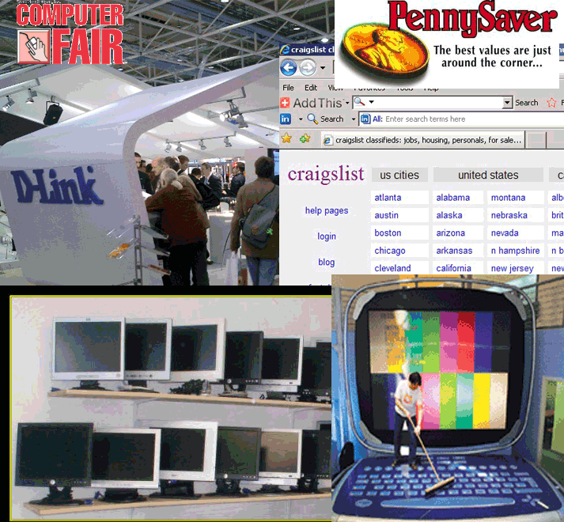
New | vs. | Used
PROS:
Simplicity
Speed
Know-how
Tech Support
Warranty Service
Bundled Software
CONS:
Cost vs. Value
Sales People
Depreciation
PROS:
50-75% Savings
Software longevity
Own BETTER than you could afford to buy new
Modularity /Upgrades
Craigslist/ Recycler/ eBay/ Classifieds
CONS:
Fear of Death
Fear of Loneliness
Fear of theUnknown
Notes:
Two more things to know about computer purchases:
#1:
Buying a used computer makes sense when price is your primary consideration and you are savvy enough to accurately diagnose problems yourself.
Although you will sacrifice speed (and perhaps life span of the mechanical components), the quality of a used $2,000 computer could easily give you better value and longevity than a computer built to sell new for under $1,000.
However:
IF YOU DON’T WANT TO DO THE HOMEWORK NEEDED TO AVOID THE PITFALLS OF BUYING A USED COMPUTER, YOU SHOULD PROBABLY BELLY UP TO THE BAR & BUY A NEW ONE.

Slide 23

VINTAGE: could YOU tell the diff?
REFURBISHED: Good as new?
Vintage
Refurbished
Never been used– just NEVER GOT SOLD
Been there, done that– got the MAKEOVER
Full OEM Warranty
Guaranteed –30-90-180 days
Full OEM Support
Online Peer Support
Notes:
And #2:
EVEN WHEN YOU BUY RETAIL, YOU HAVE ALTERNATIVES TO BUYING NEW!
“Vintage” refers to unopened items that must go simply to make shelf space for a newer model;
“ Refurbished” means it was returned by a customer for some reason— and is being marked down, after making sure everything works
Either of these categories will save you BIG BUCKS on an item you’re looking for!
Here’s how I buy big ticket items:
First, I scour tech-review websites like CNET & PC Magazine
Next, I pick two brands of something that I need— the two getting best reviews,
Then I set Google Alerts for those brands of that item— using the word "deals" next to them.
For the next few days I monitor the prices that come up, and buy when the time is right

Slide 24
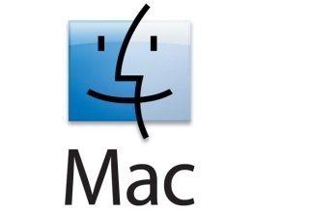
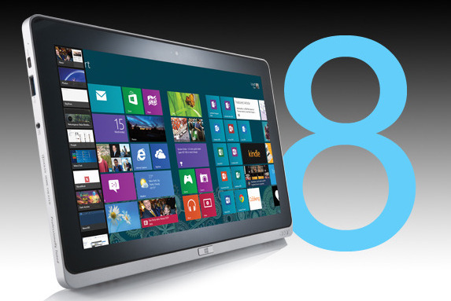



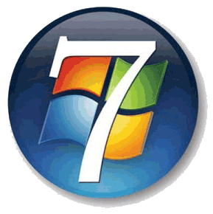

“Ask yourself this: Why do practically ALL of the world’s computers STILL run WINDOWS?” MicroSoft Founder Bill Gates | vs. | “Mac OS X powers iLife*-- all those gadgets keeping our lives fun & productive --when we’re NOT chained to a desk.” (*iPod/iPhone/iPad/iSight/iWeb/MobileMe, etc…)
WAKEUP/REBOOT TIMES | 00:12 / 01:08 | 00:03 / 00:51
Overall Performance
64-Bit Processing
Battery Life
Graphics Power
Workspace Management
Multimedia & Gaming
Touch Computing
Secret Weapons
Should Be Used By: | Bargain Hunters / Gamers / Office Users / BluRay Video | Content Creators / iLife Luxury Consumers / Techies
WithBootCamp3.0, Apple ends a cross-platform feud that’s been running since the 90s: on a Mac you can now run BOTH.
Notes:
I know I showed Linux in an earlier graphic, but they are no longer seriously competing for the PC market–
On the other hand, Linux DOES remain the world’s leading SERVER operating system, and runs ALL 10 of the world’s fastest supercomputers!!
Ok, the Mac versus PC debate may seem played out— but dumb commercials aside, both systems have their strong and weak points,
and since this goes hand-in-hand with your hardware decisions, we’ll spend a couple of minutes on this, as well:
The Mac starts faster. Period.
Mac is 31% Faster in bench tests– AND Runs Windows
Since Apple no longer offers a 32-bit version, updating an older MacBook– including the required 8GB of memory— will cost about $700;
Windows still offers a 32-bit version of 8 on the same installation disc– and if you want to upgrade your older Dell to 64-bit, the same 8GB of memory costs barely $300.
BTW: your 64-bit processor can theoretically support up to 16 BILLION GB of RAM
Apple’s MacBook’s proprietary battery outlasted the bulkier 6-cell which Dell uses by about FIFTY PERCENT!!!
Apple’s dock and desktop management tools simple & efficient; Mountain Leopard merely tweaks what users already love.
Microsoft has been playing catch-up, and Windows 8’s desktop features are quite a leap forward;
I’d say They are more or less tied in graphics NOW– but Mac got here first, with the most– so the tie goes to them…
Windows Live Essentials hasn’t been able to compete with the functionality of iLife since early ‘09.
however, Windows 8 still dominates when it comes to gaming and Blu-ray playback– once again, MicroSoft’s legacy of sheer horsepower wins the race…
Apple has done an excellent job of bringing multitouch to the masses via the touchpad.
But Microsoft has become A LOT more aggressive when it comes to touchscreen computing. Just keep in mind that all Windows 8 touch notebooks are not created equal…. Advantage Windows
Mountain Leopard has built-in support for MS Exchange—a feature Windows inexplicably lacked in 7, but corrected in 8.
Apple has made major strides toward making Mac a better fit for corporate environments—traditionally Microsoft’s “colonial empire”.
Overall, Windows PCs are great for bargain hunters, gamers or watch Blu-ray movies.
Those who want to actually create content, however, will find far more out of the box with iLife – including seamless integration with all those i-Devices out there today…

Slide 25
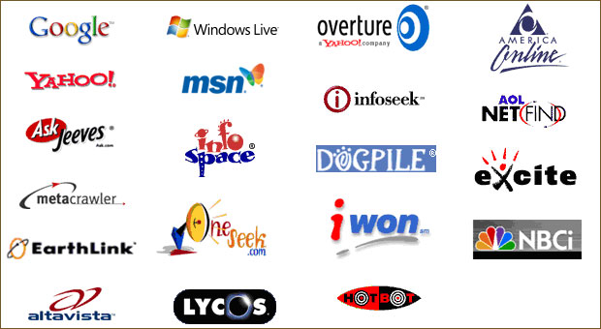

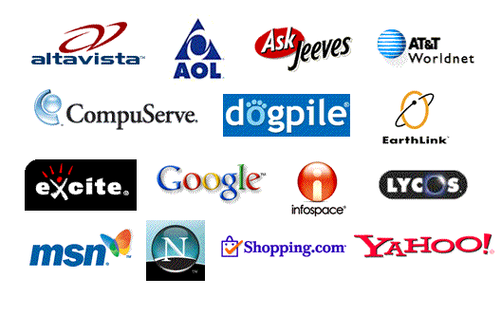

GOOGLE | vs. | BING | vs.
2000 2004 |  | 2008 2012
Notes:
Google, Bing & Yahoo continue slugging it out over who will answer YOUR next web question!!
--Forget the old “Search Engines”– today they’re more like a “Cyber-CONCIERGE”
I’m a Google guy— however, when I went on BlindSearch, a sort of search engine “taste test”,
I was stunned when I found that I chose Bing EVERY TIME– even when the search term was “Google”!
However, the fact is that Google’s user-friendly interface & interactive modularity (maps & search engine & image catalogs all work together) keep it at the top of the pile–
Indeed, they are nearly twice as popular as #3 Yahoo…

Slide 26
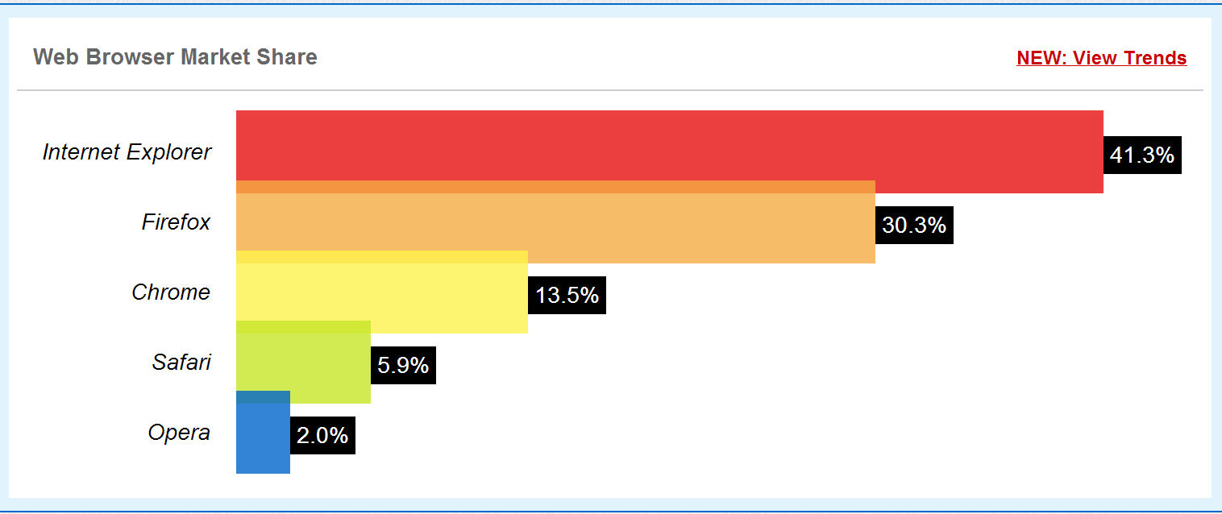
Web Browser Usage Stats: 2010
Notes:
these next 3 graphics say a lot about just how quickly the landscape can change in cyber-space:
Two years ago, Microsoft’s Internet Explorer & Mozilla’s Firefox dominated web searches—
with upstart Google in a distant third place...

Slide 27
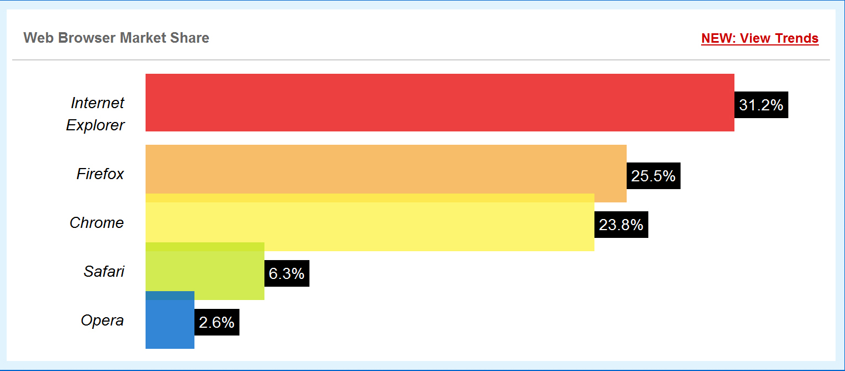
Web Browser Usage Stats: 2011
Notes:
in the next 12 months, Google DOUBLED its market share—
with nearly two-thirds of that gain coming at Internet Explorer’s expense,
and Firefox still valiantly hanging in there!

Slide 28
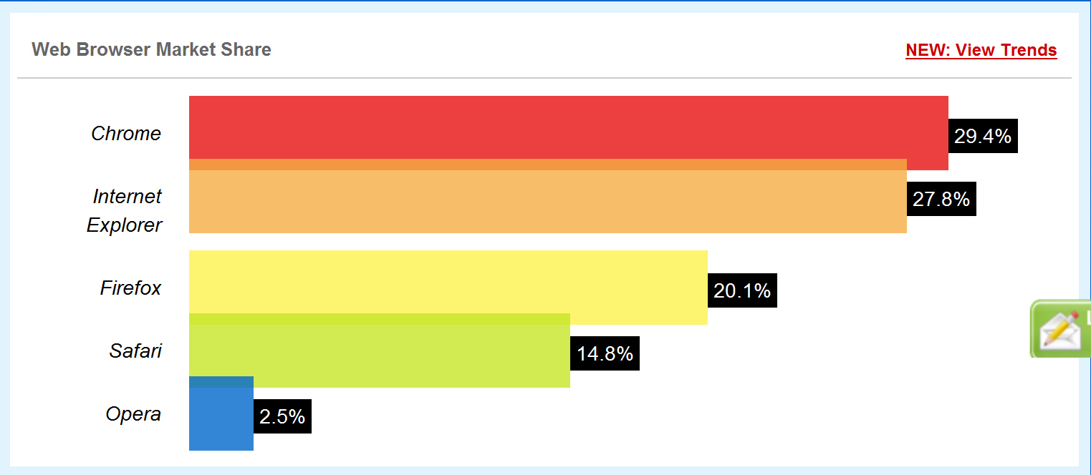
Web Browser Usage Stats: 2012
Notes:
In just two short years, Google has become a juggernaut which seems poised to rule cyberspace for the foreseeable future—
although Microsoft is definitely not giving up without a fight: as I mentioned before,
their new & improved search engine, BING, may actuall be changing the game yet again...

Slide 29

how the internet works
Notes:
Okay, that’s enough about computers for now—
let’s talk about that wonderful thing that made EVERYBODY decide they needed one:
(PLAY VIDEO)
THE INTERNET!

Slide 30

navigating cyber-space:
How can you find ANYTHING in this mess?
Notes:
in the next 90 seconds, this little clip explains how the Domain Name System (DNS) makes the internet possible
(PLAY VIDEO)

Slide 31

getting yourself on the web
Notes:
Okay, this is what many of you came here for today:
to learn how to use the web to market yourself
(PLAY VIDEO)

Slide 32

creating your website
Notes:
As you’re watching this video, just remember that IOSantas provides nearly-free web design & hosting to everyone in the Christmas Community—
PLEASE TAKE ONE OF OUR CARDS BEFORE YOU GO
(PLAY VIDEO)

Slide 33


is a wide-open frontier
Cyber space
So, get out there & MAKE YOUR MARK
Which brings me to ANOTHER point:
It’s called a “Domain Name”–
and it costs about $10/yr…
Notes:
Oh, and one other thing I wanted to mention:
Do you think it matters WHO OWNS YOUR NAME?
What about your Stage Name or Company Name…?
What about that once-cute-but-now-potentially-humiliating nickname you would give anything to keep your ex from naming her anti-YOU stalker-blog?

Slide 34

Whoaaa!!! ho! Ho! ho-ld on a second, e. z. wider
R-O-A-D
T-R-I-I-P !!!!
First, let’s check traffic on the ol’
INFORMATION SUPERHIGHWAY
Notes:
At the beginning of 2003, it was estimated that ten percent of the world population had access to Internet.
This is an amazing number given the fact that the Internet was virtually unknown just 8 years earlier!
But let’s compare that to the Internet that would exist 8 years later—

Slide 35

Just A Few Internet Statistics
Notes:
here are a few internet statistics from 2012
(PLAY VIDEO)

Slide 36



Total usage in 2012 increased by 50%— IN A SINGLE YEAR!
Notes:
SOCIAL MEDIA NOW RULES THE INTERNET.
PERIOD.

Slide 37

Notes:
Of course, the term “Social Media” has expanded a bit, to include things that are not really shared in real time—
like suggestions to friends & family about watching videos, or listening to music, or viewing photographs, etc...

Slide 38

Four million “likes”!
The most popular FACEBOOK post of all time!
Notes:
For instance, this was the most shared photo in FaceBook history—
millions of shares per minute, and a total of FOUR MILLION LIKES

Slide 39

One billion hits!
The most popular YouTube video of all time!
Notes:
On a related note:
we Americans sometimes need to be reminded that we are only 5% of the Earth’s population—
and our monopoly on the internet is a distant & fading memory...
As people’s exhibit 1, I submit the most popular YouTube video of all time:

Slide 40

One billion hits!
The most popular YouTube video of all time!
Notes:
Gangnam Style, an amateurish dance video from a South Korean artist calling himself “Psy”
(PLAY VIDEO)
As of this week, it’s been viewed more than 1.23 BILLION times!!!

Slide 41

Crawl Before You Surf
Okay, I got a computer–
NOW WHAT?
Notes:
PACE YOURSELF– you don’t want to become an early burnout… And REMEMBER:
Personal computers & the Internet have helped more people make worse mistakes faster than any other combination of human inventions– with the possible exception of Tequila & Handguns /
Oh, and don’t be embarrassed about getting help from your kids or grandkids– the average 12-yr-old could run everything in this room for us— while texting with the other hand…

Slide 42

For More
Information:
Professional peer training:
www.FORBS-MIGS.ning.com
Nearly-Free Hosting & Design:
www. WINTER-net.us
Tips & troubleshooting:
Webmaster@IOSantas.com

Slide 43
DISCUSSION PERIOD
Questions?
Comments?
Suggestions?
Anecdotes?

Slide 44


Connecting devices to your pc
Notes:
I don’t want to wander too far into the technological ephemera surrounding the torrent of peripheral devices available for your computer
—a category which stretches from printers to external storage devices, to players and to media drives;
but I would like to make a point about HOW those devices interface with your computer— which mostly means how you connect them...
Even the quickest quad-core, multi-stack-architecture processors can only work with data as fast as the peripheral can deliver it!
Here’s the best-kept secret in computing is that your computer spends ALMOST ALL ITS TIME waiting—
and the thing it spends the MOST time waiting for is usually YOU!
If you are can speed up the data transfer speeds to & from the computer, your processor can spend more time WORKING!
USB is the most universal connection type in the world— and for the most part, that still means USB 2.0;
However, USB 3.0 is one of the fastest interfaces for connecting peripherals— and as prices continue to fall, it is rapidly becoming the most cost-effective, as well
Here is a comparison chart that shows popular interface speeds today:
At 4,800 Mbps (4.8 Gbps), USB 3.0 is significantly faster than USB 2.0, FireWire 400, and FireWire 800 as well as the common SATA 1.5 and 3.0 standards.

