Slide 1
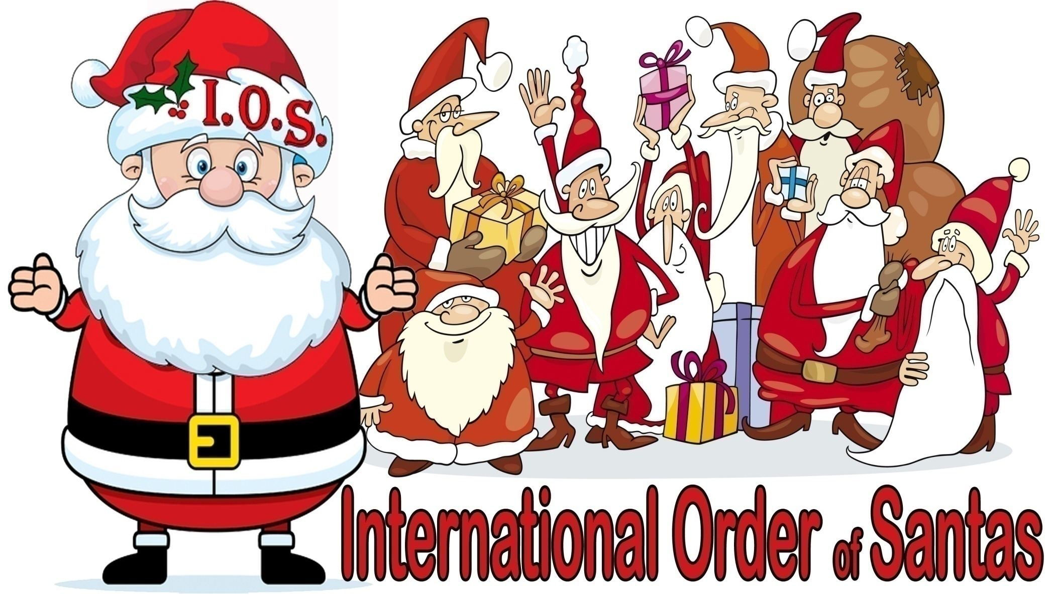
Well, hel-LO-HO-HO!

Slide 2
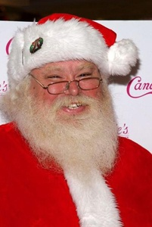
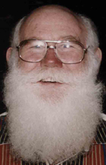
Santa Ric Erwin here…
I have BIG news for members of the International Order of Santas!
But first, I’d like to take just a moment to explain (if not apologize for) our rather “leisurely” growth rate the past year or so
Let’s begin by thanking our FOUNDER— he’s the man who literally started the global
Real Bearded Santa phenomenom in 1994, our “Reluctant Hero”: Santa Tom Hartsfield

Slide 3
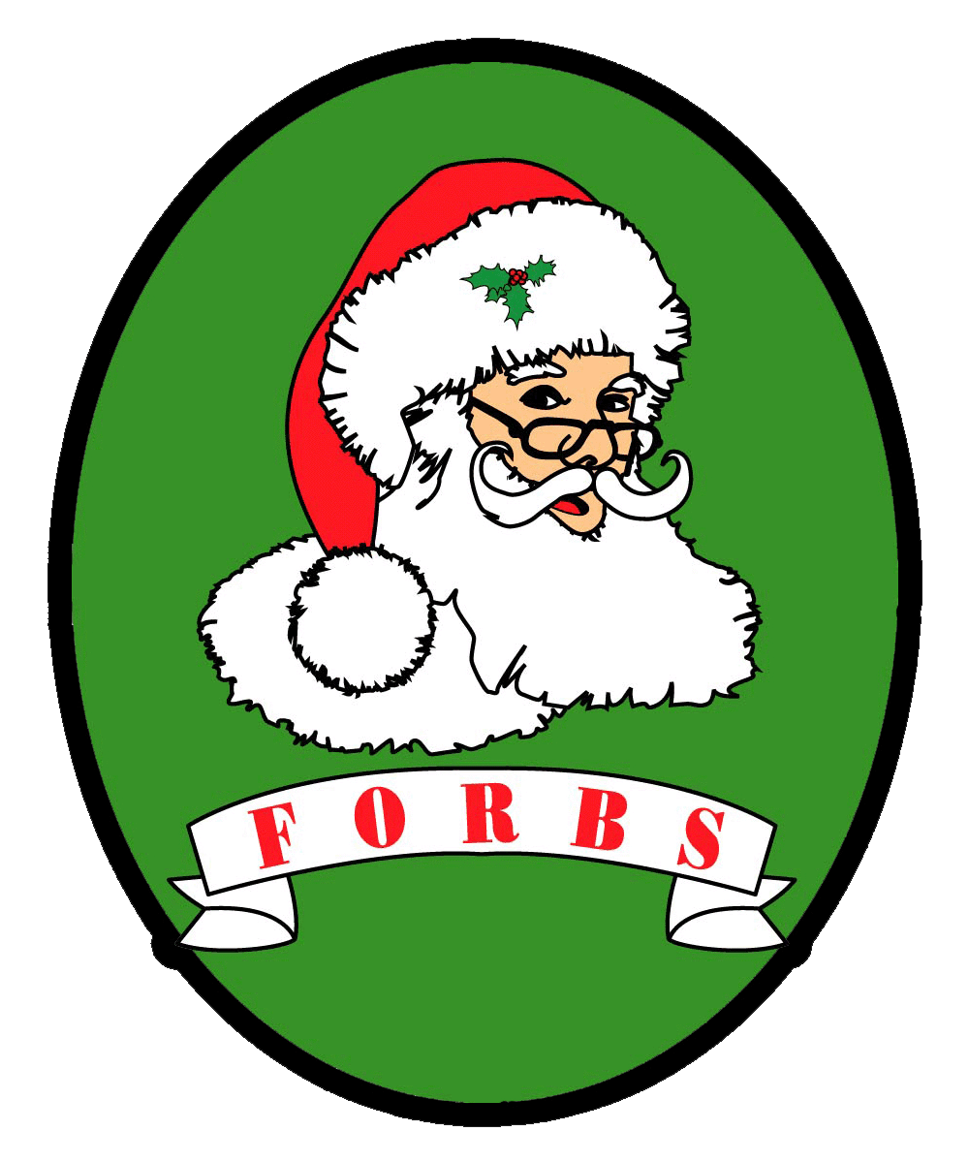
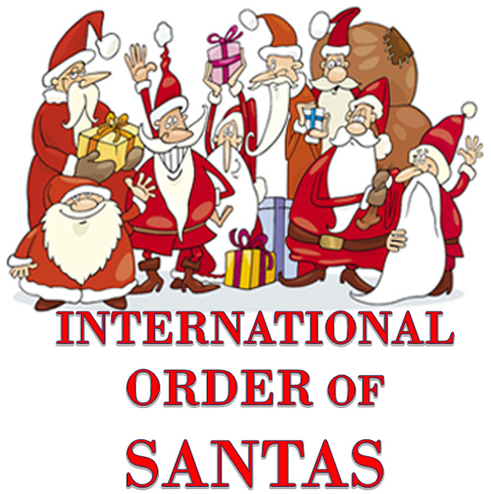
Born, APRIL 2008: Fraternal Twins
As our story begins, the old Amalgamated Order lies a smoking ruin.
Then, rising from the ashes—like a pair of glorious Phoenixes: (Phoenii? Phoenices?) FORBS & its fraternal TWIN, IOS.

Slide 4
Like many of you, I JOINED BOTH
In loyalty to my friend & mentor Tom Hartsfield, & out of frustration for having failed to help him rescue his 15-year labor of love from the clutches of 2 evil & greedy men—I joined IOS
And, in solidarity with my SoCal Santa Pals — among whom Diva & I had lived, loved, worked, played, laughed & cried for so many years—
(and against whom I have all too frequently felt the frustration of AUDITIONING) there was never any question that we would ALSO join FORBS
Also like many of you, I started helping as much as I could,
by doing what I LOVE to do—for BOTH GROUPS!

Slide 5
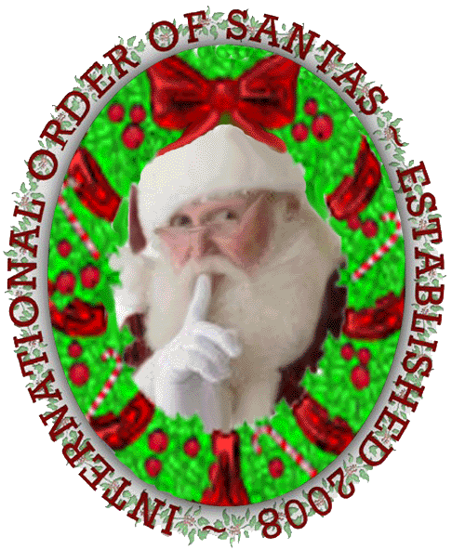
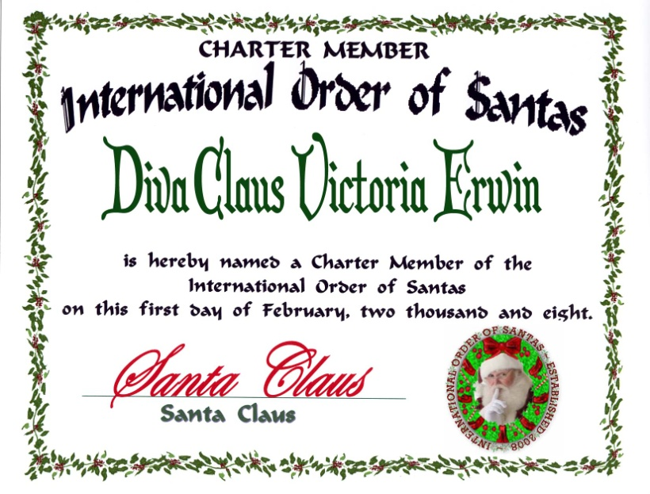
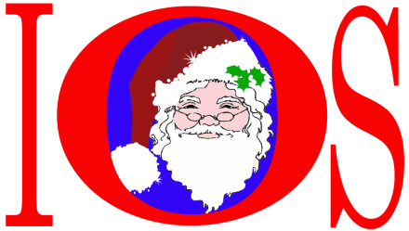
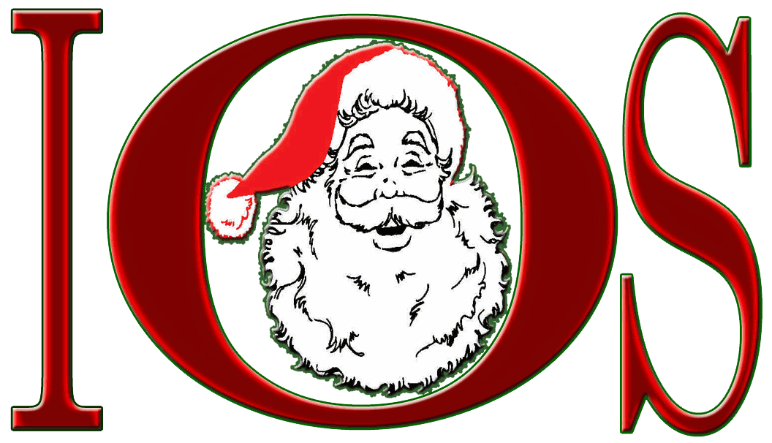
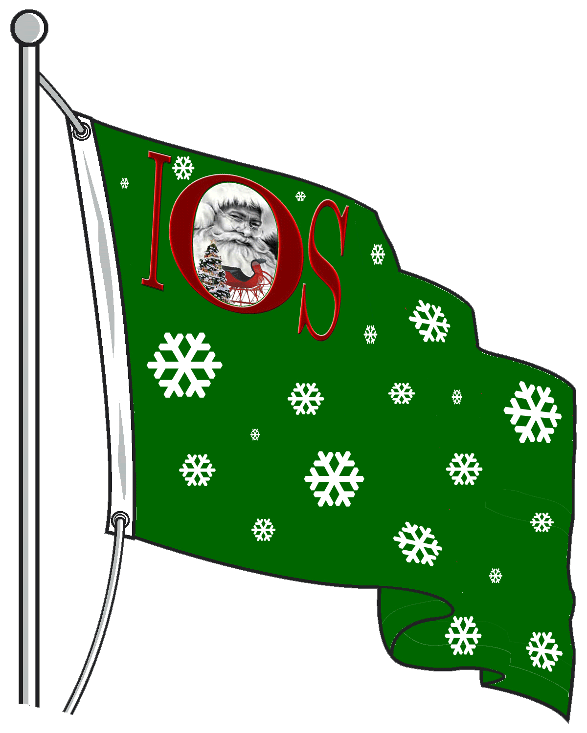
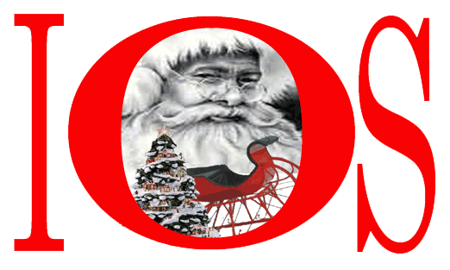
First, for IOS:
Basing the logo on Santa Milt Cottrell, who had passed away just as IOS was starting up, I helped Tom Hartsfield create a Membership Certificate, “Flag”, Chapter Banner(s) & stationary samples:

Slide 6
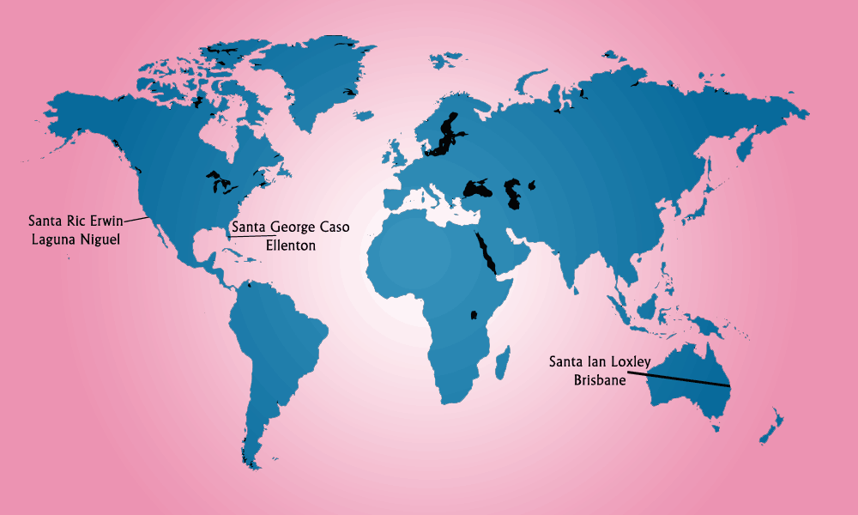
I also served on the global design team working on the IOS Website:
Visit us online at: www.IOSantas.com

Slide 7
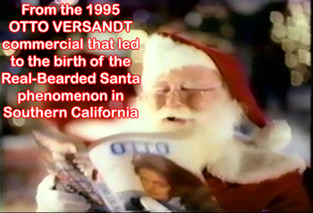
Still, guess who was doing most of the heavy lifting…
Considering his general lack of techno-savvy, I can only wonder at the amount of work it must have taken Santa Tom Hartsfield to compile the boxes of records which he turned over to me…
Tom eagerly accepted all the tutoring we could find time for— he went from struggling with emails to working with huge database spreadsheets!
When, a year later, he made up his mind to permanently retire & move out to the countryside with his family,
IOS had HUNDREDS of members around the world!
WOW!!!

Slide 8

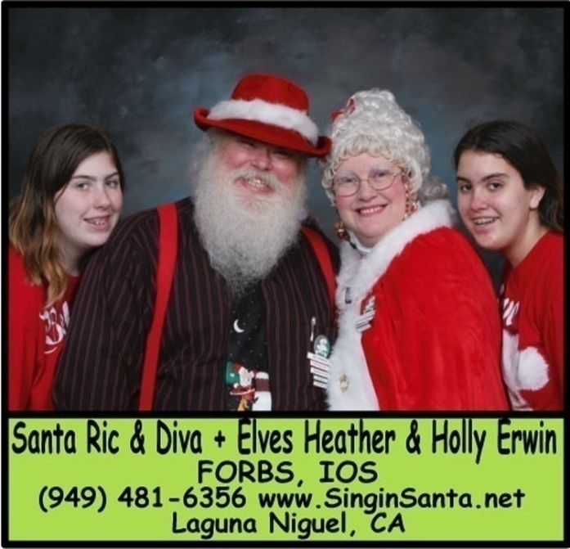
Incredibly, during these same years, there was even MORE going on at the
Fraternal Order of
Real Bearded Santas
Before we return to the subject of IOS’ future, I’d like to thank my lovely & beloved wife Victoria for giving me support—both figuratively AND literally— while I spent long days, weeks & months working for FORBS.
I’d also like to thank Elves Heather & Holly
(BOTH Christmas plants, BTW—chosen LONG before I became Santa)
for making parenting so STRESS-FREE for me!
Finally— before moving on, I’d also like to tell those of you who are NOT members of FORBS
How I Spent The Past 30 Months:

Slide 9

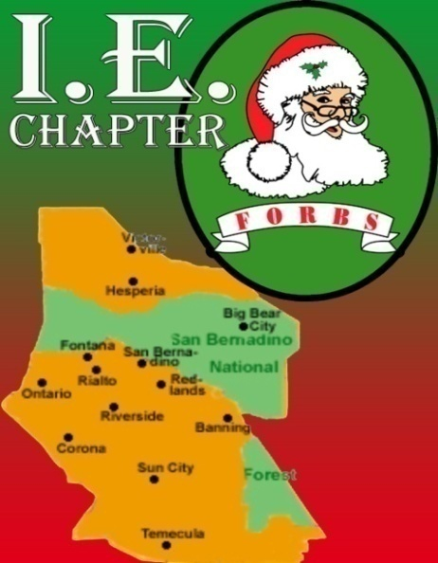

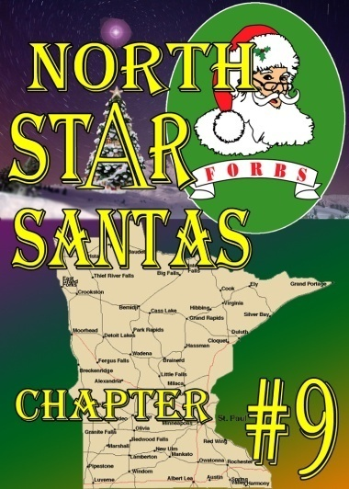

When FORBS was born in April 2008, Diva & I were there—and we’ve been there ever since!!
I’ve served FORBS as:
Director-At-Large
National Secretary
National Webmaster
Orange County Ch. V.P.
Archivist & Videographer
I’m also Webmaster for the following chapters:
In fact, for most of the past two years, I’ve actually been ALL of the above AT THE SAME TIME…
Professional singers year-round, Diva & I LOVE to perform pro-bono for our fellow Jolly Jents—and for many of their causes! We’ve hosted fundraisers, led meetings, entertained parties, taught workshops–
we even MC’d two FORBS Luncheons!

Slide 10
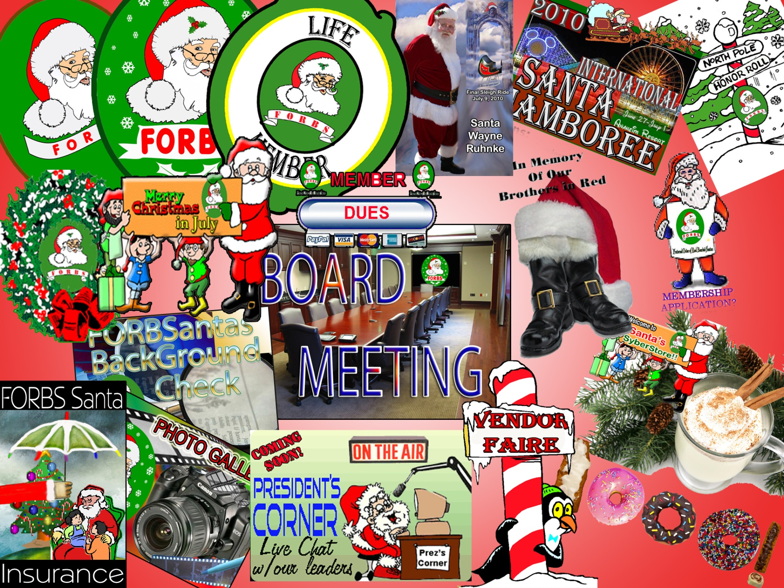

Most entertainers have a “day-job”, right? Well, my Computer Science degree is older than the internet, so I do web & graphics design—here are some I’ve done for FORBS:
Additional information, galleries & samples online at: www.LiteraryMercenary.NET

Slide 11
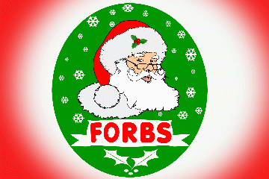
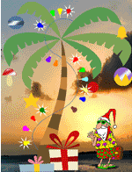
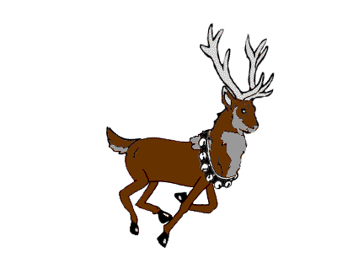
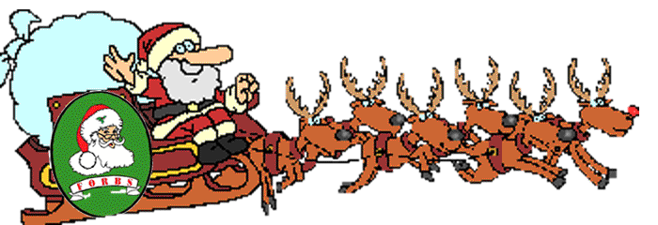


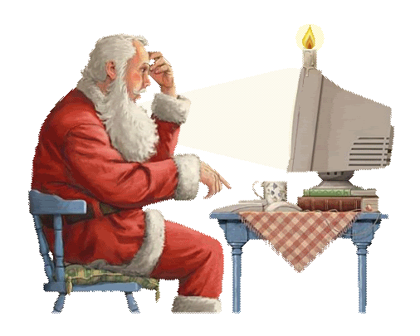
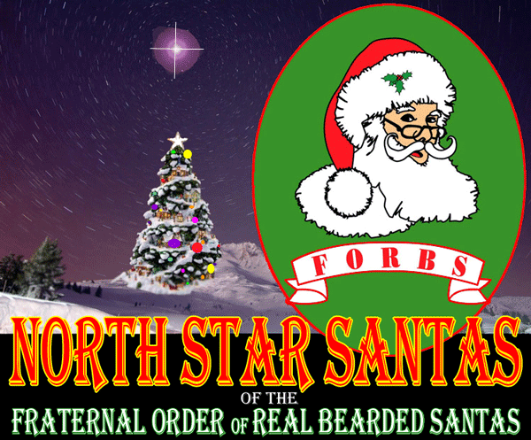
I even think my MOTION GRAPHICS are getting better…

Slide 12
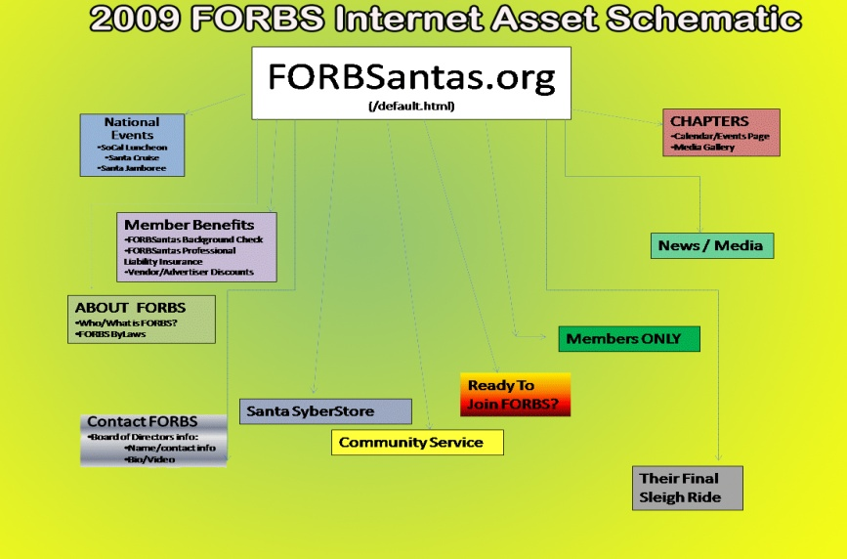
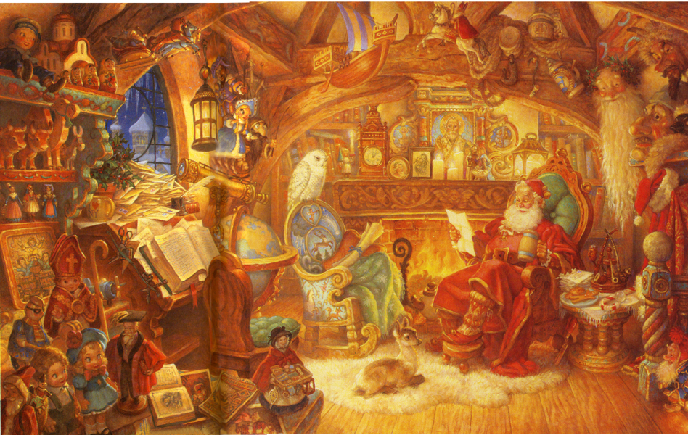
While National Secretary, I wrote or revised (wholly or in part) many of FORBS’ most important documents– for instance:
ByLaws (Rev. June ‘09)
Conflict Policy
Life Membership Policy
Media Access Policy
Trademark & Logo Policy
Background Check Protocols & Procedures
eCommerce Policy
Luncheon Press Packet(s)
Santa Jamboree/Crowne Plaza Settlement
+ Meeting Minutes/ Press Releases/ Committee Reports/ Forms, etc…
“A volunteer is someone who has conquered their personal inertia;
but inertia almost ALWAYS counter-attacks & quite often succeeds…”
From US To ME: Working With Volunteers, Santa Ric Erwin
Notes:
12

Slide 13
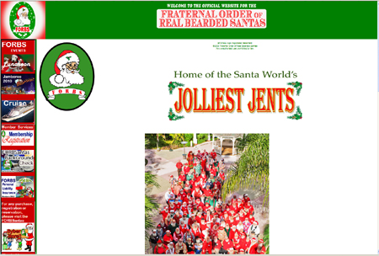
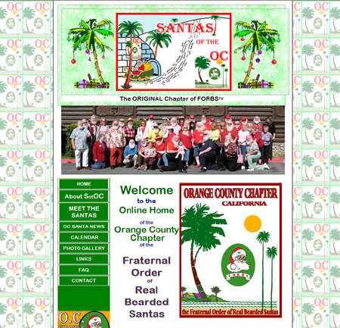
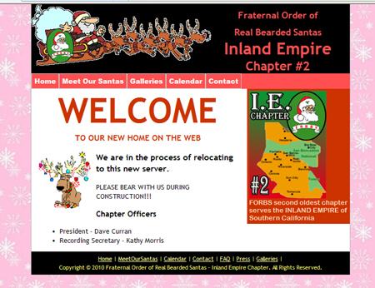
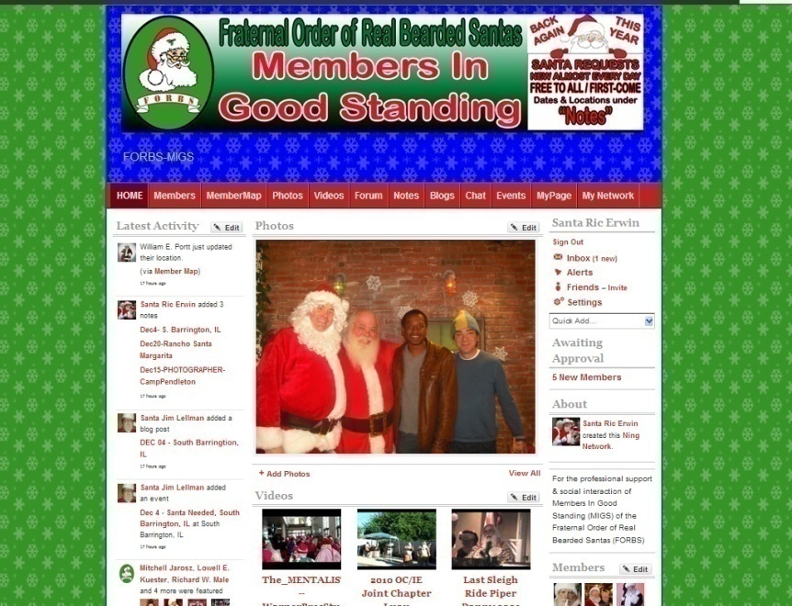
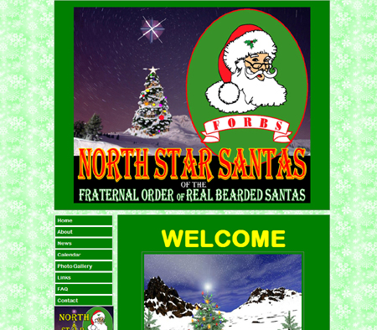
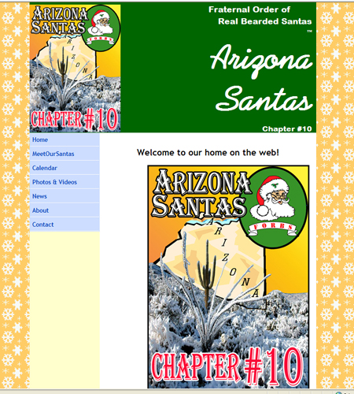
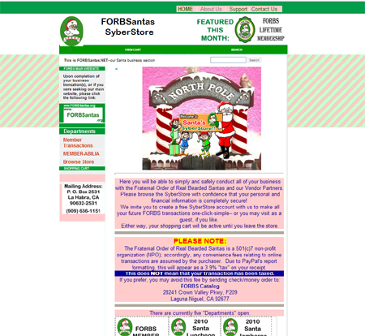
As FORBS’ National Webmaster, I built our entire network:
Including the “Santa SyberStore”
(which produces about 85% of our income!)

Slide 14

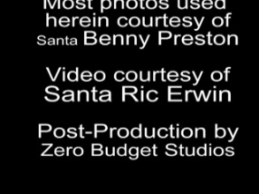
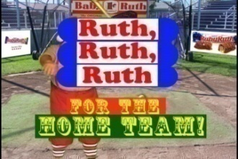
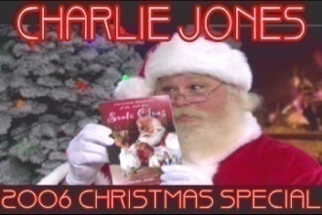
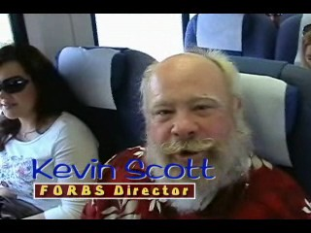

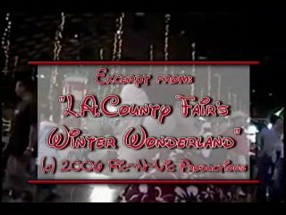
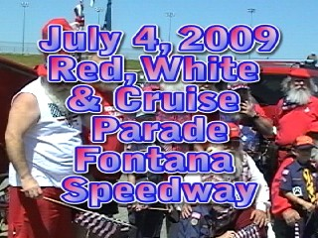
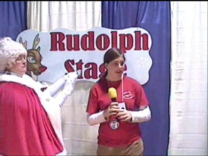
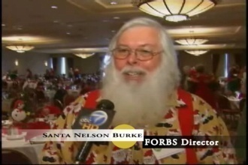
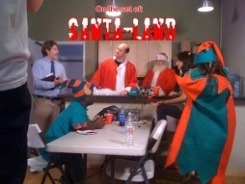
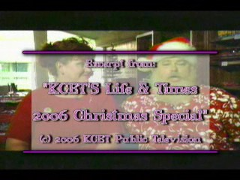
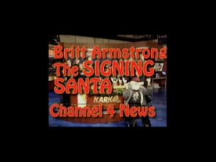
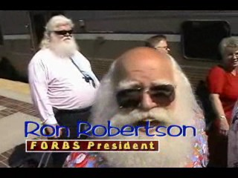
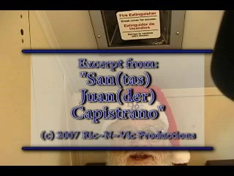
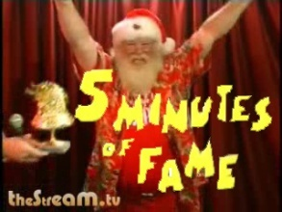
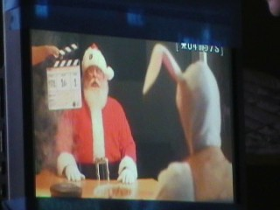
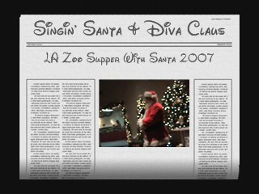
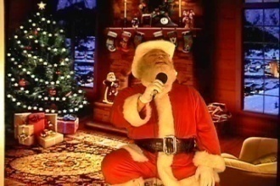
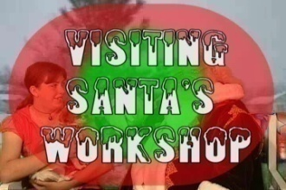















Our production company has done a LOT for our bros, too!

Slide 15


WHEW!!
Ever stared at the time stamp on an email from me & wondered WHEN I SLEPT?
Well, to me it’s not how MUCH I sleep— BUT HOW WELL!!!
And THAT has been the source of my energy & stamina for years:
after an exhausting life once spent chasing profits & prestige,
I NOW SLEEP THE SLUMBER OF THE SAINTS!!!
I KNOW that what I’ve lost in QUANTITY
I’ve MORE than made up for in QUALITY!

Slide 16

What about all those holiday specialists who are NOT Real Bearded Santas?
Don’t you know a few who’d LOVE to share what we have?
Well…. WHO SAYS THEY CAN’T??

Slide 17

The International Order of Santas is launching:
That’s why today, after many months of planning,
HERE’S WHY WE’RE SO EXCITED:

Slide 18

You know what’s the HOLY GRAIL of Web Design today?
UNIVERSAL
TRANSLATION!
The Bible says the people of Babel decided to show God their greatness— by building a tower to heaven; for this hubris, He scattered them to the winds, and then imposed “languages” to KEEP them apart. (Gen 11:1-9)
Notes:
18

Slide 19

Soon, your personal associations will no longer be limited by your LOCATION OR your LANGUAGE
—You Can Have Friends ANYWHERE IN THE WORLD!
Here’s what your “CONTACTS” list may look like in a few years:
We KNOW it’s coming—
the only QUESTION is:
HOW CAN WE HELP OUR MEMBERS GET READY FOR IT ?

Slide 20


With your help, IOS will soon provide all interested Seasonal Professionals with:
IOSantaNet
A simple, feature-rich Social Network for the NON-techno-geek… (like, say–your average SANTA?)
FINALLY synch up w/ family/friends/fans on FaceBook/Twitter/etc
A “private party line” that allows the entire Christmas Community to share friends SAFELY
Peer support, tutorials, & professional training
Don’t get frustrated— get INTEGRATED!!!
“YellowPages” for IOS members
Show the world what you do or sell
Share photos & video, true or tall tales, etc
Link your profile to a pre-existing website (if you have one)
Or let us build a website FOR you
IOSyber-Store
Products / Services offered BY members FOR members
Shop OR browse—by, Product, Vendor or Category
Peer reviews & feedback
Turbo-SSL Security
Can you say,
“CROWN JEWEL”?
…and I KNOW we can do all of this– because we’re DOING IT NOW—for SANTAS!

Slide 21

Ok, Ric, sounds good...
I DO think FORBS is GREAT,
& I can think of lots of folks who’d LOVE to share what we have with each other here; so I won’t mind if you
CUT TO THE CHASE...
            ONE FINAL QUESTION:

Slide 22

JUST
HOW
MUCH
IS ALL
THIS
GONNA
COST????

Slide 23

Brace yourself–this might hurt a bit: for almost ALL of this, you will pay…NOTHING
At least, nothing most of us haven’t paid ALREADY:
For the first time since 2008, IOS will again collect annual dues...
All new members, as well as existing members who’d like a 2011 Membership Certificate
EXISTING MEMBERS may retain their
current roster position for only
$10
$5
IOSyberStore will open soon; meanwhile, dues can be paid using any major credit or debit card, via our website & PayPal: www.IOSantas.com

Slide 24
HERE’S AN OVERVIEW OF THE 3 TIERS OF SERVICE
As you can see, the more likely a member is to use any available service, the more UN-likely they’ll PAY for it!
(fee based)
IOSyberStore
WINTER-Net
IOS’ Virtual Offices or ”WEBquarters”—
where each Chapter has a public directory–
each Member designs their own “Showcase”—
& every Vendor has a prominent “Display Window”
(free Member placement, optional premium support available)
IOSantaNet
(free access—to IOS Members ONLY)
We are, after all, a SOCIAL organization FIRST, right?
EVERY MEMBER will be encouraged to create a profile– and to use it to get to know fellow members from around the world…
Our “Virtual Clubhouse”, IOSantaNet will even find ways to teach the member to do all this ON THE FLY—using the device in their pocket!!

Slide 25

IOSantaNet (IOSantaNet.ning.com)
“Intended for the social interaction, professional integration & peer support of members of the International Order of Santas”
-IOSantaNet
Mission Statement
If the entire, global Christmas Community is a big happy family
(with WILDLY varying work schedules)
-then THIS is our cyber-living room.

Slide 26
Likewise: if IOSantaNet is our living room, then WINTER-Net will be our home–office… you might even call it our “WEB-quarters”
WINTER-net will be our public face on the internet–a sort of Christmas Community Yellow Pages
Members with products or services of interest to Seasonal Professionals / Specialty Performers / Bookers / Agents / Makeup Artists / Toy Makers / Custom Costumers / Writers / Media Relations / etc, etc, etc…

Slide 27
eCommerce w/IOS & Our Members
This is REALLY where the RUBBER MEETS THE ROAD!
By FAR the most complex of all the websites I made while serving the Fraternal Order, the FORBSantas SyberStore had FIVE departments listing over a HUNDRED products…
But I designed it to be INFINITELY SCALABLE—
which means once it opens, the
IOSyber Store
will let HUNDREDS of vendors offer THOUSANDS of products to our global membership!!!
Notes:
27

Slide 28



Well—that’s our plan for the Christmas Community in 2011
This year, our goal is to help EVERY MEMBER become more familiar with the INFORMATION SUPERHIGHWAY!!!
Soooo…
Whaddya say,
E. Z. Wider
Ready for a
ROAD TRIP?
Notes:
28

Slide 29

If you have any questions or problems, let me know:
Director@IOSantas.com
We’ve already begun to roll out some of these services– others will come online as resources permit; when you’re ready to start, go to:
www.IOSantas.com
Feel free to browse the site all you like, and when you’re ready, just follow the “Join IOS” link you’ll find on most pages
To help us keep our roster accurate, please complete the brief Membership Application (even if you’ve completed one before)
We haven’t opened the IOSyberStore yet—so for now we’ll only be accepting the following:
  $5 -- Legacy renewals only (no certificate)
  $10 -- 2011 Member Dues (w/Certificate)
  $25 Annual Dues + Donation
This last button is for those members who REALLY feel the Christmas Spirit during checkout—
THEY WILL BE OUR North Pole Honor Roll

