Slide 1

Notes:
Yes, I know— you’re already an actor. That’s true!
Also, no matter how or why you became a Santa, you probably get paid for doing it.
So you’re both a working actor & a professional actor already.
But for this workshop, we’re going to use that word in its traditional, Hollywood sense.
Inside the industry, a working actor is anyone who is paid to perform dramatic (or comedic) works.

Slide 2


Why Do you Want To Be An Actor?
Notes:
But if you're wondering what it takes to make it in the acting field, you need to ask yourself one very important question:
Why do you want to become an actor?
If you answer is that you want to be rich and famous, you might as well stop right now.
Please don't confuse acting with being famous or being a celebrity...that's something totally different.
As an actor, can you become famous? Absolutely. But being famous alone doesn't make you a good actor.
Almost anyone can be an actor. But not everyone is willing to put in the work and effort that it takes.
Like any art, acting takes hard work and passion for the craft. The business can be gruelling and almost always involves a lot of rejection.
There are thousands of actors who work a lot, without ever making enough money at it to support themselves— much less a family...
Keep in mind that a working actor may have a steady stream of jobs, but not be able to support him-/herself by acting jobs alone.
Their life is always the next audition, the next gig...

Slide 3


Do you REALLY Want To Be An Actor?
Notes:
The journey to becoming a successful actor is a marathon, not a sprint.
There are four things you need to be an actor (listed in order of importance):
Experience, training, talent and professionalism.
As we will discuss later, at some point you hope to be in need of an agent,
but I wouldn't worry about that until you've accumulated at least 6 months to a year of working on your craft.

Slide 4



types of ACTING jobs
TELEVISION / COMMERCIALS
Notes:
Acting is acting, right? If only it were that simple.
Depending on the medium, different skills must be employed.
Theatre requires exaggerated movements & vocal projection.
Film acting is much closer to reality.
Because the "audience" is now the camera (and eventually those watching what the camera captures), the acting style is much more intimate.
There is no need to project your voice, as film sets are equipped with sensitive sound recording devices.
Commercial Acting can be the most demanding:
Cameras are able to zoom in to capture the slightest eyebrow flinch, so less is much more.

Slide 5



types of ACTING jobs
TELEVISION / COMMERCIALS
Notes:
If any of you are going to get started in acting, the most likely place will be on TV—
But that word covers A LOT of territory:
it could mean a cable series, (PLAY VIDEO)
Or a public-access talk show— (PLAY VIDEO) Most communities have public access channels— call your cable company
OR Public Television (PLAY VIDEO) Public Television is national (and sometimes even international) exposure— wouldn’t you do it for free?

Slide 6



types of ACTING jobs
TELEVISION / COMMERCIALS
Notes:
Being on TV could also mean appearing in a commercial
These samples demonstrate market ranging:
from local (PLAY VIDEO)
to regional (PLAY VIDEO)
to national (PLAY VIDEO)

Slide 7

types of ACTING jobs
TELEVISION / COMMERCIALS
Notes:
And by the way— are all of you aware that the entire
Real Bearded Santa phenomenon began in 1994—
with a tv commercial?
(PLAY VIDEO)

Slide 8

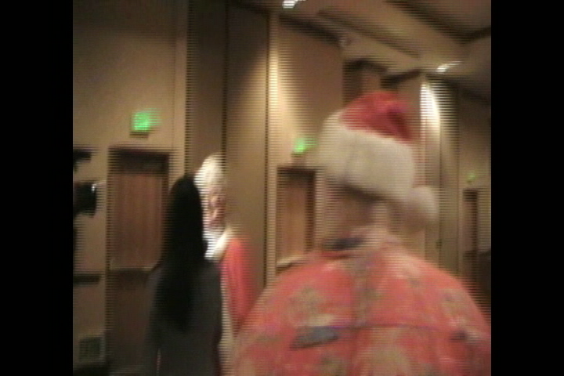
types of ACTING jobs
TELEVISION / COMMERCIALS
Notes:
Oh, and one more point:
you can also be on TV WITHOUT being paid:
YOU SHOULD ALWAYS BE READY TO DO AN INTERVIEW—
PRACTICE AT HOME! (PLAY VIDEO)
You can also pad your media resume with the occasional entertainment news or other info-tainment appearances
(PLAY VIDEO)

Slide 9
types of ACTING jobs
TELEVISION / COMMERCIALS
MOVIES / FILMS
Notes:
I’ve been an entertainer for nearly 40 years now, watching from the inside as the industry changed dramatically right along with the rest of the world
I’ve witnessed the birth of cable & the internet — and over the years I’ve come to differentiate between “Movies” and “Films”:

Slide 10
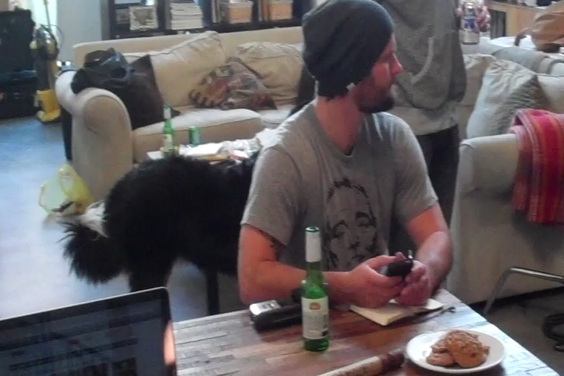
MOVIES
TELEVISION / COMMERCIALS
MOVIES / FILMS
Notes:
To me, “MOVIE” refers to a big-budget project for a major studio— complete with full cast & crew.
MOVIES are without a doubt the holy grail of most acting careers!
(PLAY VIDEO)
I don’t care how many projects I’ve been involved in— as you can see from my B roll footage:
I AM INVARIABLY IMPRESSED BY THE CONTROLLED CHAOS OF A MOVIE SET!

Slide 11
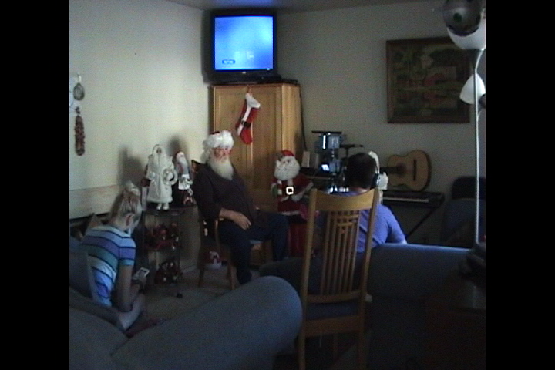
FILMS
TELEVISION / COMMERCIALS
MOVIES / FILMS
Notes:
(PLAY VIDEO)
On another branch of the same tree, we find “FILMS”—
To me, this refers to smaller, lower-budget projects:
primarily the independent & documentary films which are usually not shown on on the major networks;
This category also includes so-called “Reality Programs”—
at least until they are picked up by a cable channel...
After that, they usually acquire budgets that promote them out of this category...
This is from a recent shoot for an indie project being produced by New York’s Double Windsor Films
You may know several Santas involved in this project— this is Director/Cinematographer Tommy Avallone

Slide 12
types of ACTING jobs
TELEVISION / COMMERCIALS
MOVIES / FILMS
STAGE / THEATRE
Notes:
Theater acting -- or stage acting -- is the earliest — and some would argue purest— form of the craft.
In the olden days, actors had to be prepared to project their voice long distances...or at least to the last row of the audience.
This technique is called "projecting to the back of the house.“

Slide 13


STAGE & THEATRE
TELEVISION / COMMERCIALS
MOVIES / FILMS
STAGE / THEATRE
Notes:
Of course, these days, most actors are mic-ed, so projecting is not much of a problem.
In addition, movements of the body had to be larger-than-life so they could be seen by members of the audience.
Small movements like a facial expressions are simply too minuscule to "read," so other methods had to be used to express emotion: pacing, dialogue, etc.

Slide 14
types of ACTING jobs
TELEVISION / COMMERCIALS
MOVIES / FILMS
STAGE / THEATRE
EXTRAS / BACKGROUND
Notes:
Your first step into acting should probably be to join a class;
but if you have never been on a set before, the next step is to get some set experience.
While you’re getting started, do some work as a background actor, also referred to as “Being an extra.”
By working background, you learn the etiquette of being on a set!
If you could be someone's stand-in, that's even better because as a stand-in you literally get to do what the actor you're standing in for does.
It's like being paid to practice!

Slide 15

THE mENTALIST
TELEVISION / COMMERCIALS
MOVIES / FILMS
STAGE / THEATRE
EXTRAS / BACKGROUND
Notes:
Here’s a great example:
Most network series’ record their Christmas episodes in the late summer & early fall.
This shoot for the Mentalist was the largest paid gathering of Real Bearded Santas in history!

Slide 16
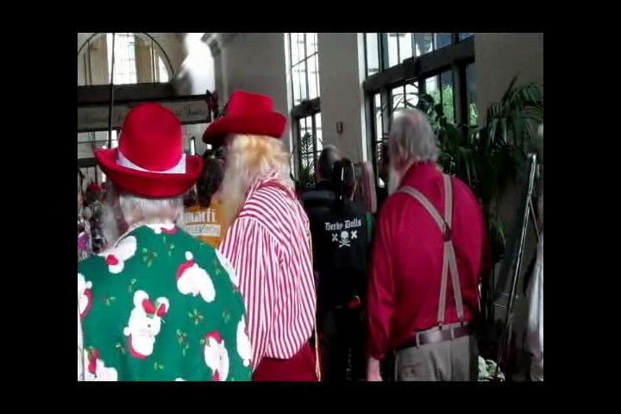
THE MENTALIST
TELEVISION / COMMERCIALS
MOVIES / FILMS
STAGE / THEATRE
EXTRAS / BACKGROUND
Notes:
And this is what it looked like from the EXTRA’S perspective...

Slide 17
types of ACTING jobs
TELEVISION / COMMERCIALS
MOVIES / FILMS
STAGE / THEATRE
EXTRAS / BACKGROUND
INTERNET / LIVE FEED
Notes:
This last category is the one most often ignored by “old-school” actors;
I’m probably lucky that my day job is working with computers—
When I said earlier that I witnessed the birth of the internet from the inside,
I MEANT TWICE!

Slide 18

types of ACTING jobs
TELEVISION / COMMERCIALS
MOVIES / FILMS
STAGE / THEATRE
EXTRAS / BACKGROUND
INTERNET / LIVE FEED
Notes:
My computer science degree is older than the internet— I can program in THREE DEAD LANGUAGES!
I was doing graphic & software design in the early 90s, when cable TV came to my hometown—
And I climbed onboard that new-tech bandwagon for awhile!

Slide 19

types of ACTING jobs
TELEVISION / COMMERCIALS
MOVIES / FILMS
STAGE / THEATRE
EXTRAS / BACKGROUND
INTERNET / LIVE FEED
Notes:
When I became Santa Claus, I incorporated the two personas without batting an eye!
ever since, I’ve kept a hand in both sides of the entertainment industry!

Slide 20



INTERNET / LIVE FEED
TELEVISION / COMMERCIALS
MOVIES / FILMS
STAGE / THEATRE
EXTRAS / BACKGROUND
INTERNET / LIVE FEED
Notes:
And believe me when I guarantee each & every one of you that the INTERNET is the future of entertainment!
Sadly, that’s ALL I can guarantee— because this branch of the media tree is evolving a hundred times faster than motion pictures EVER did!
And it’s not just the improvements in technology— which are pretty mind-blowing!]
More than anything, it’s the PROLIFERATION of technology—
TODAY EVERYBODY HAS ACCESS TO EQUIPMENT THAT YOU HAD TO BE ELVIS TO GET, WHEN WE WERE KIDS!!!
(PLAY VIDEO)
And the internet is changing the way COMMERCIALS are made, too!
StarGreetz, an online company providing digital messaging, had me record over 1000 NAME variations alone—
Along with all 50 states, a long list of relationships, etc, etc— allowing the customer to create a customized video greeting card
(PLAY VIDEO)
The next year, they brought me back as “The Recession Santa”
(PLAY VIDEO)
The Intel/Dell commercial you saw earlier was this same sort of campaign—
several parts of it were automatically personalized based on the recipient’s FaceBook profile— then appeared in their browser as a normal advertisement!

Slide 21
OTHER types of show biz jobs
VOICE-OVER / NARRATION
Notes:
With the advent of the internet, it is possible that established and new talent can have a thriving career in the voice over industry through online casting websites.
Whilst there are sites that allow any person to join, a new wave of 'professional only' casting websites are emerging.
In an industry where radio and television voice overs can be recorded in home studios because of technology becoming so affordable, high paying jobs are no longer sourced exclusively through traditional voice talent agents
Again, referencing the Intel/Dell campaign, I recorded the tag line at the end in my office, and sent it to the studio via email attachment...

Slide 22

VOICE OVER / NARRATION
VOICE-OVER / NARRATION
Notes:
But there ARE still Voice Over jobs to be had, if you have the right connections!
I recorded this video during a Voice-over Session two weeks ago for the Travel Channel.
We did sides for about 8 different programs, but this will give you an idea what its like to work in a sound booth
(PLAY VIDEO)

Slide 23
OTHER types of show biz jobs
VOICE-OVER / NARRATION
GALLERIES / STILLS
Notes:
Sometimes a movie studio will hire an actor rather than a model, to do the teasers & promotional graphics

Slide 24
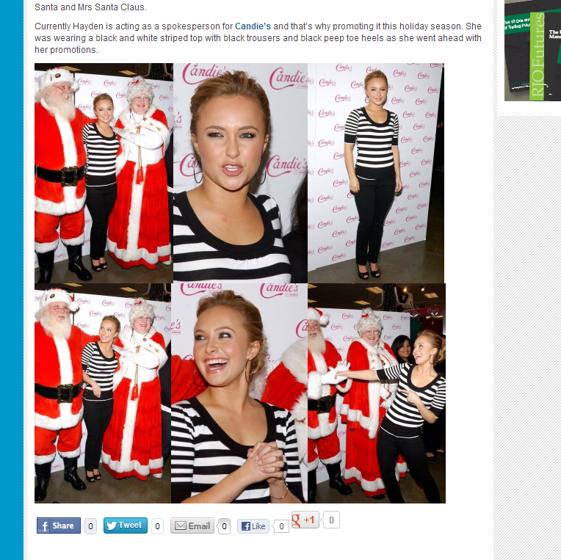
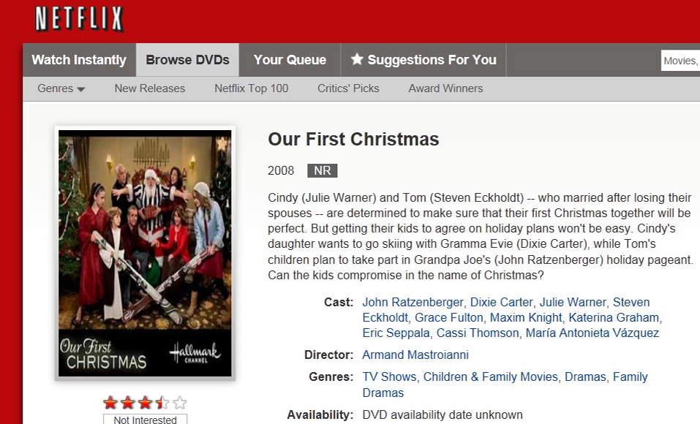
Galleries / stills
VOICE-OVER / NARRATION
GALLERIES / STILLS
Notes:
While you are not actually IN the movie, it is on your resume that you worked ON the movie!
Sometimes a live celebrity appearance gets picked up nationally as a stills spread, too

Slide 25

GALLERIES / STILLS
VOICE-OVER / NARRATION
GALLERIES / STILLS
Notes:
(PLAY VIDEO)
This is one I did a few years back for Hallmark—
I was on set the full day with John Ratzenberger, Dixie Carter & the rest—
And I earned nearly $1200 —
But I wasn’t in a single frame of the film

Slide 26
OTHER types of show biz jobs
VOICE-OVER / NARRATION
GALLERIES / STILLS
COMEDY / STANDUP
Notes:
If YOU don’t think you’re funny, don’t even try it;
But if you can deliver standup comedy before a live audience,
YOU CAN DO ANYTHING!!!

Slide 27
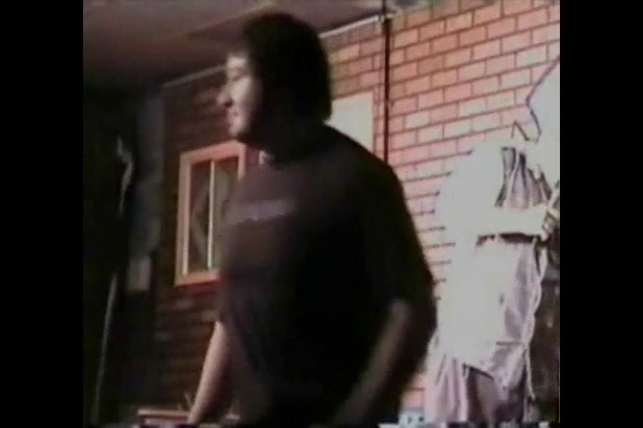
Comedy / standup
VOICE-OVER / NARRATION
GALLERIES / STILLS
COMEDY / STANDUP
Notes:
This was recorded at Hollywood’s HaHa Café—
The year after I became a Santa
(PLAY VIDEO)
If you’re interested, the rest of that set is available on my YouTube page

Slide 28

if I do want to act, where do I start?
Notes:
OK you're headed into L.A. with dreams of starring in the next Santa blockbuster.
There's just one little problem—
you don't have an agent. So what do you do?
For Hollywood newbies, attracting an agent can be a daunting process.
Most agencies won't reveal whom they represent, and if they do, the clientele is subject to change without notice.
The "Big Four" only sign those who've been referred by an industry insider, existing client or mutual friend.
Still, there are a few essential steps every newbie has to take:
fortify the resume, get headshots, and network like your life depends on it.

Slide 29
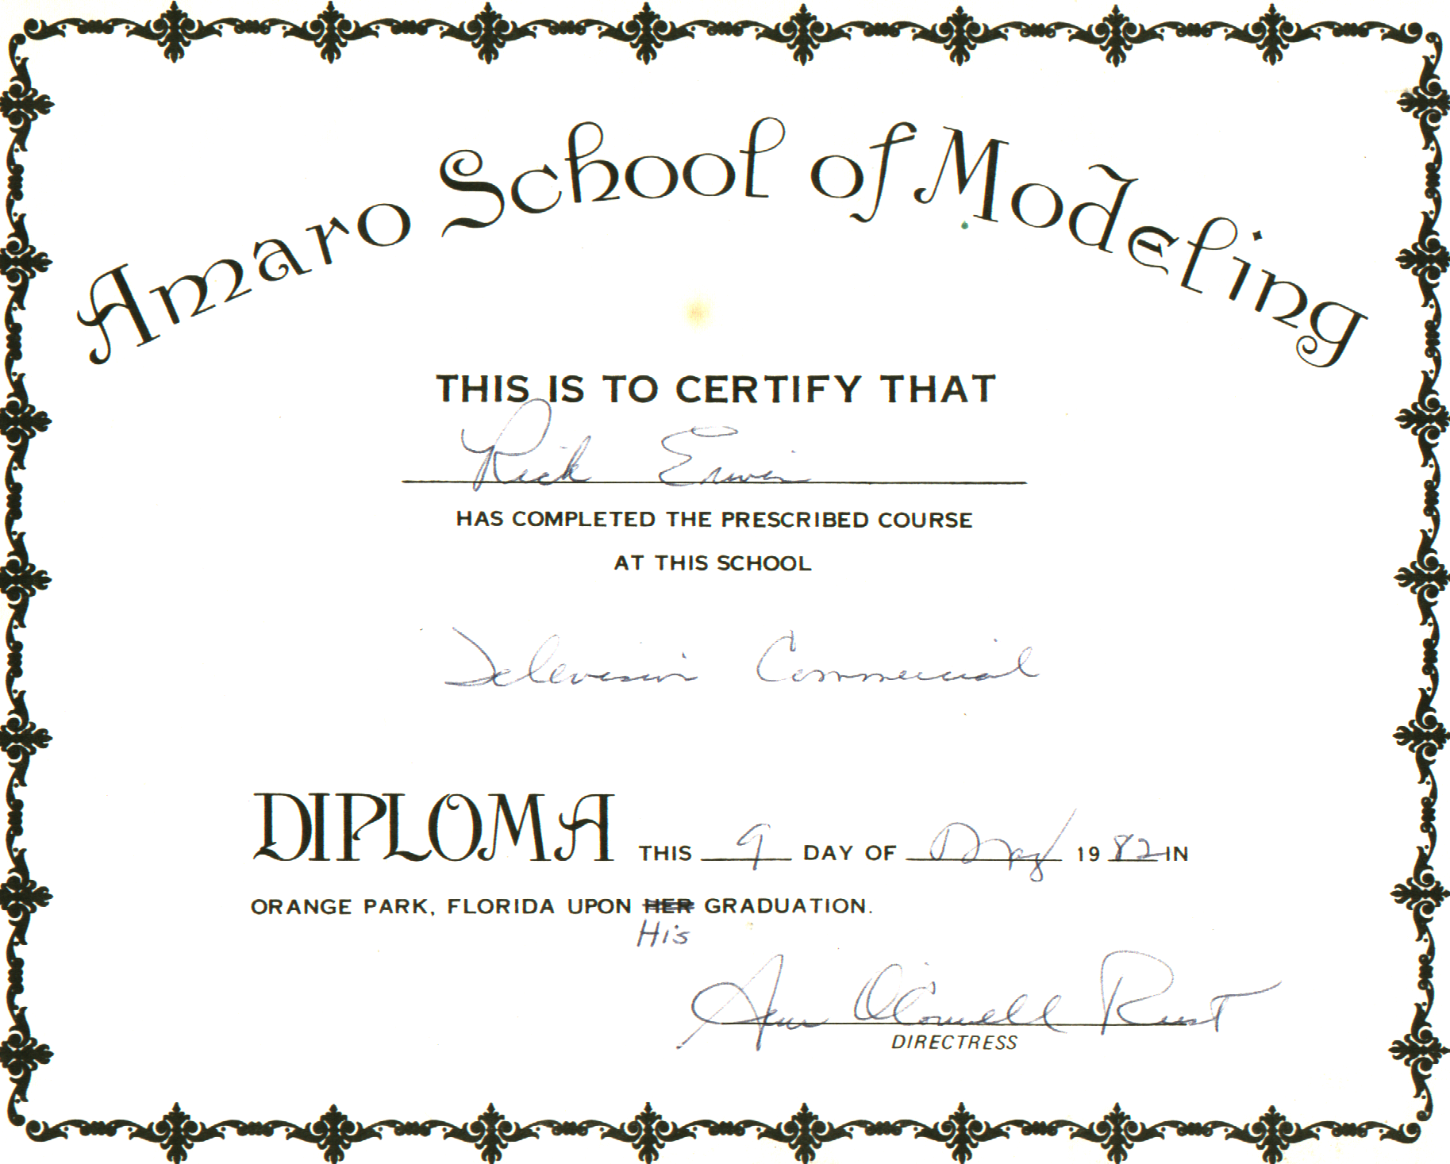
CLASSES? BACK TO SCHOOL AT MY AGE?
Notes:
Do you really need acting classes?
Odds are, you do. Most every actor benefits from regular classes, particularly at the beginning of his/her career.
I took my first acting class back in 1982, from the Amaro Agency— in North Florida
It’s hard to read because it’s so old, but this diploma says,
Rick Erwin has completed the prescribed course at this school: Television Commercial
This 9th day of may, 1982 in Orange Park, Florida upon His (they had to scratch out “HER”) graduation
And it’s signed by Ann O’Connell Rust—a close friend of Eileen Ford.

Slide 30




L.a.-area acting coaches & classes
Available by email request— but a word of warning:
this is Los Angeles— the list is 140 PAGES!!!
Notes:
You should seek training that will help you to develop your strengths and assuage your weaknesses.
Don't be afraid to try new things.
Take every opportunity you can to add new and different skills and training to your repertoire. It's certain you'll discover new strengths that you never knew you had.
Typically, the first year in any dramatic education program, includes acting classes in Improvisation. Improv skills are vital to any actor.
As much as you may hate the idea, do take classes that offer exercises that scare you or put you off (like monologue work, audition technique, or musical theater).
These are often the best indicators of where you need to improve, so diving into these areas of weakness can only make your skills stronger.

Slide 31
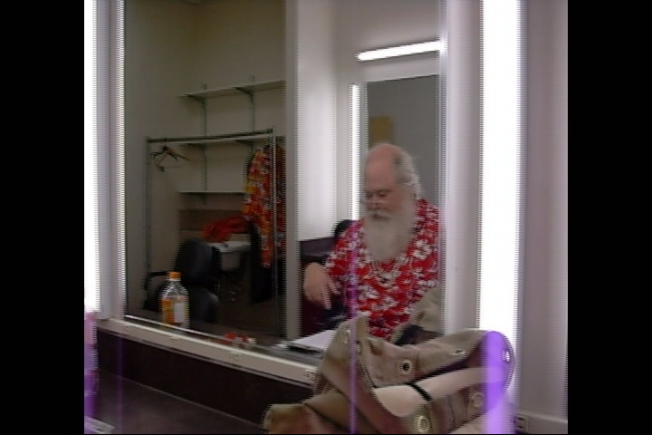
Cold Reading: just stay cool!
Notes:
“What is Cold Reading?” Cold reading is a term used in acting.
It is when you are given material that you have never seen before and you are given a short period of time, usually 10-30 minutes if you're lucky, to prepare it and present it to a casting director, producer, director or writer.
(PLAY VIDEO)
If you have never done a cold read before, it can be a nerve wracking experience...
But to be better at cold reading you only have to practice —
Start with reading out-loud— a book, a magazine or a newspaper—
and don't just read: read with comprehension and emotion.

Slide 32
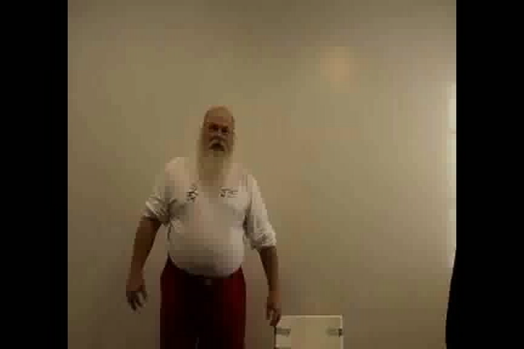
Call backs
Notes:
For most actors, you won’t start getting paid until your first “Call Back”—
A call back is just what it the name implies:
You have attended a cattle call or casting call, and based upon your performance,
the director, producer or client have move you onto their “short list” for the part.
(PLAY VIDEO)
You will normally be paid industry scale for a call back— plus transportation & per diem costs.
THIS IS YOUR CHANCE TO GET YOURSELF HIRED— so don’t hold back.

Slide 33
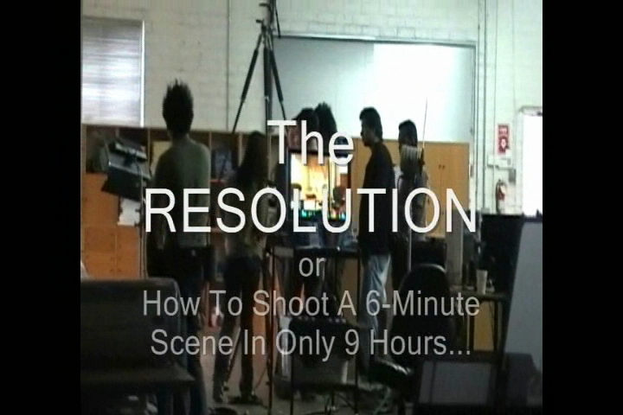
BE A STUDENT FILM STAR
Notes:
There are plenty of opportunities for actors to find work throughout the year— Not all acting jobs are commercial acting jobs!
Acting in student films is a valuable way to gain both experience and exposure.
(PLAY VIDEO)
A role in a student film allows you to practice your acting skills while enhancing your resume.
You get to work with the industry's up-and-coming directors.
Student films are often shown at international film festivals, providing a valuable opportunity to display your acting talent.
An additional bonus is that more often than not, student directors will hire non-union actors, so you won’t need to worry about having to join SAG to get film acting credits on our resume!
Keep in mind that you probably won’t get paid on a student film.
You will generally receive free transportation and food as well as copies of the film on DVD or tape, as payment.

Slide 34

1st commandment: THE DIRECTOR IS GOD
Notes:
PLAY VIDEO
I mean no disrespect to anyone’s religion, but if you want to know how to keep your acting career going, heed these words:
The director is God.
If you don’t believe me, ask yourself this:
Pick any actor in the world & ask them what they want to do next, and their answer will probably be: DIRECT
The director has final say in any play, program, or film your work on— so check your ego at the studio gates
If you disagree with your director, don't waste his time— not to mention irritating the cast & crew—by getting into argument on the set!
This is why you should resolve any questions about your lines or wardrobe BEFORE you shoot!
I cannot stress this point enough:
even if you somehow found yourself in the unlikely position of being forced to choose between pleasing the client, the producer or the director—
PLEASE THE DIRECTOR...
He will have more impact on your acting future than everyone else on the set— combined!

Slide 35
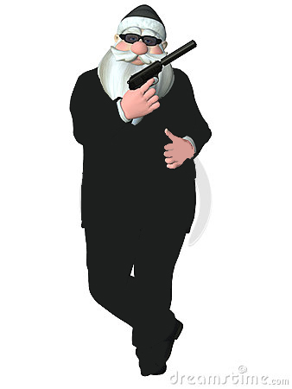



Santa + agent = ?
NO, SILLY—
WE MEAN THESE:
Notes:
An agent is an actor's representative. Once an agent represents you, you are his or her "client." They will submit you for roles and try to get you seen by casting directors. They will take 10% of your gross pay once you book a job. They will negotiate your fees and your contracts, and are your greatest professional advocate.
Agents represent lots and lots of clients. They're busy, and they may not even be looking for new clients.
Getting any agent is hard enough, and getting a great one is usually a career-changer for any actor.

Slide 36
What's A MANAGER—& Do I Need One?
AGENT:
The main difference is this: agents are licensed by the state.
In most states, they get no more than 10% of your earnings
Agents have access to casting notices and casting directors.
They can make auditions happen.
MANAGER:
Managers are not regulated.
They can charge whatever percentage they wish … 25%, 30%, etc.
Different managers offer different services.
Managers generally have fewer clients than agents, and can offer more individual attention.
Notes:
Managers also work with actors; they specialize in guiding your career, working with casting directors and advising you on all aspects of the business.
What they share in common with agents is that they work to get you jobs, they work on commission (that is, they take a percentage of what you earn as an actor) and they represent you to other industry professionals.
While working with an agent is generally the best idea for new actors, managers can be very helpful.
(You probably don’t want both; otherwise you may be doling out 35% to 40% of your acting income to your representation!)

Slide 37
tips for starting without an agent:
ALWAYS Have Headshots With You!
Notes:
An agent can be helpful for actors and actresses, but when you first start out, getting one may be difficult, especially if you don’t have much experience in the industry.
However, that doesn’t mean you can’t get work. It just means you’ll have to be diligent about doing the legwork yourself.
Once you start to pick up steady work, you can consider working with an agent to help you get high-profile jobs and parts you may not otherwise know about.
The important thing is to keep getting out there and keep being seen.

Slide 38
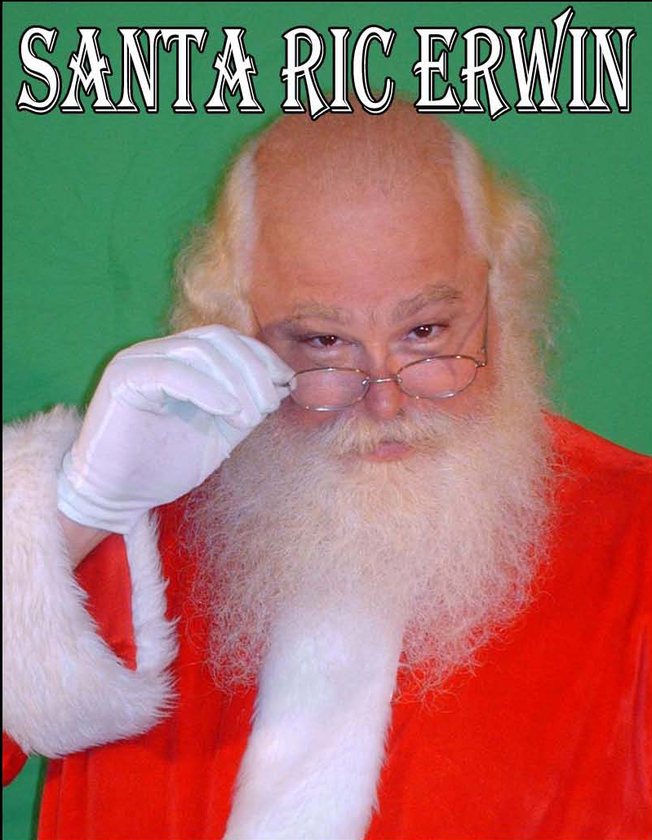

Notes:
Have professional 8” x 10” head shots ready to give to casting directors at all times, even when you aren’t at an audition. Your head shot should look like you – no retouching should be applied. If you change the color of your hair or get a different haircut, you need to update your head shots.
Your head shots should also include your name and contact information.
A composite plate may be submitted, as well— so long as it is dominated by an actual headshot

Slide 39
tips for starting without an agent:
ALWAYS Have Headshots With You!
Keep Your Resume With You— And CURRENT!
Notes:
Keep up-to-date copies of your resume along with your head shots on hand at all times.
Limit your resume to one sheet and make sure the font is 10-point or larger.

Slide 40
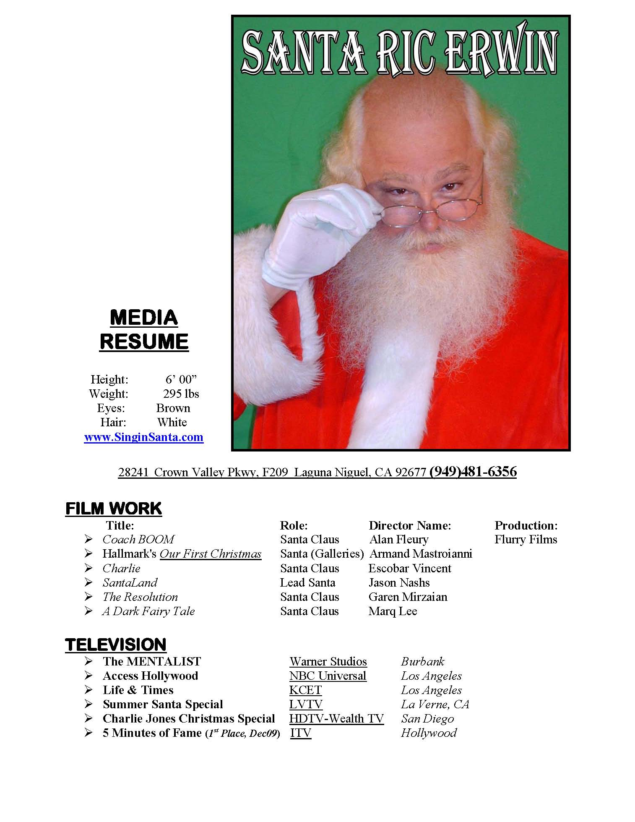


Notes:
Limit your resume to one sheet and make sure the font is 10-point or larger.
Highlight relevant work experience, separating work into categories like theatre, television and commercials.
Don’t include high school plays— although college work and education is acceptable, especially if you attended a school with a strong acting program.
Useful skills like juggling or dancing should also be included.
If you don’t have anything to put on your resume, take some classes at a local community college or university and audition for community theatre productions to build your resume.

Slide 41
tips for starting without an agent:
ALWAYS Have Headshots With You!
Keep Your Resume With You— And CURRENT!
Become An EXTRA!
Notes:
Audition for and join a casting service that books actors for minor roles in commercials, television and films.
Like most major cities, LA has a variety of different casting services that book these types of projects.
You’ll need to take your head shots & resume, and probably audition when you for such a casting service.

Slide 42
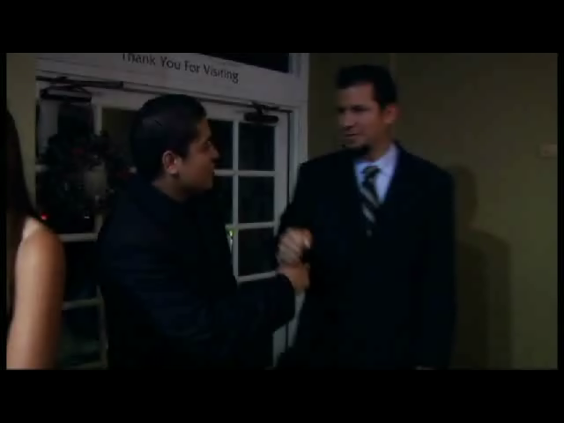
I got my first imdb listing with this:
Notes:
Don‘t blink— or you’ll miss me!
Also: you can tell It’s a student film, by the shadow from the microphone over my head!
(PLAY VIDEO)

Slide 43
tips for starting without an agent:
ALWAYS Have Headshots With You!
Keep Your Resume With You— And CURRENT!
Become An EXTRA!
Breakdown Sheets
Notes:
Subscribe to one of the casting call publications, also called “breakdown” sheets, for open auditions and casting events in the Los Angeles area .

Slide 44

L.a.-area Breakdowns sheets
( No Representation Required)
http://www.backstage.com/
https://www.cazt.com/auditions
Notes:
Breakdowns are usually published in the morning and can be browsed online with a membership.
There are also free services, such as http://casting.backstage.com

Slide 45
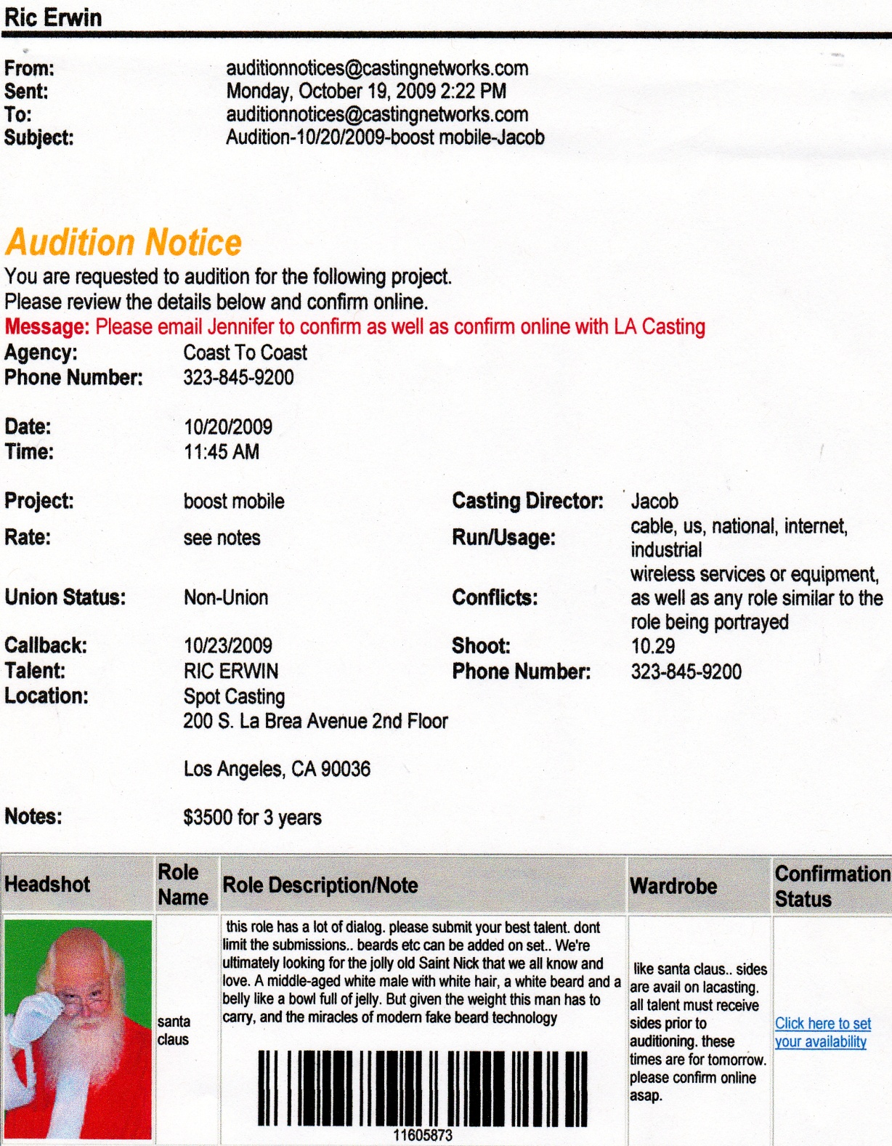
L.a.-area Casting services
(Representation Required)
www.castingfrontier.com
www.actorsaccess.com
Notes:
To use the industry insider’s casting boards, you will HAVE to find an agent—
But once you do, your acting life will get MUCH easier & more productive!
For one thing, you get to see EVERYTHING being cast in the area, by EVERYBODY
Not just the studios & networks, but more importantly by the indies & students—
Where most of us earn our stripes before the big buck ever start rolling in...

Slide 46
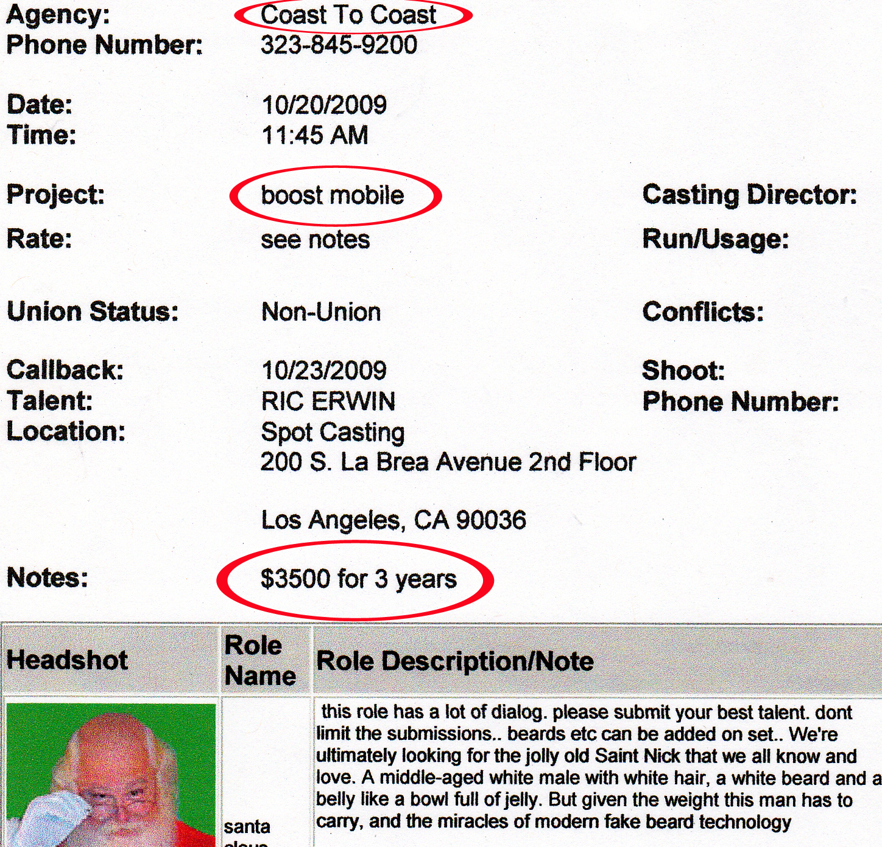
L.a.-area Casting services
(Representation Required)
www.castingfrontier.com
www.actorsaccess.com
Notes:
For another thing, when you start getting offers to do the big (and more lucrative) gigs,
You don’t have to pit yourself against the studios or networks over how much you’ll be paid—
Your agent will handle all of that FOR YOU.
And you can rest assured that he’ll get as much as he can— he’s fighting for HIS paycheck as well!

Slide 47
I hope you’ve enjoyed the workshop
Notes:
If time permits, proceed to “HOW TO GET AN AGENT”

Slide 48
How to Get an Agent
There are three basic ways an actor gets an agent. They are:
1. The agent sees your work and calls you in for an interview.
2. You are recommended to the agent by a casting director, director, producer or fellow actor who is a client of that agent.
3. The agent calls you in for an interview because of your P/R (photo and resume), which he or she received in the mail.
Notes:
It used to be that young actors did “mailings” -- sending headshots, resumes and cover letters to agencies “cold”; that is, with no contacts. Today that’s like throwing your headshots directly into the trash.
Getting an agent to see your work is the best way to get representation, because they really need to get to know your work before they can represent you to the best of their ability. Even if you get an agent interested via another route, they'll probably want to see you in something before they'll represent you.
One of the best ways to meet agents is to go to an agent or casting director workshop, where they get to audition for a number of agents or casting directors, as the name says, one on one.
It’s sort of like speed-dating for actors –but you may have to pay to attend these workshops.

Slide 49
Getting an agent to see your work.
Scene Nights
Notes:
Scene nights are events in which actors try to be seen by industry people. Rather than putting on a play, a group of actors will put together scenes that show them off.Hundreds of invitations are sent out to agents, casting directors, and directors.
Many times schools will have these nights as a wrap up for a course of study. If you can get into one of these scene nights, I highly recommend it. They offer good opportunities for up-and-coming actors to show off their best work to industry people.
If casting directors also come to these evenings, they may see you and call you in without representation.

Slide 50
Getting an agent to see your work.
Scene Nights
Agent Workshops
Notes:
Some classes offer an industry night as part of their curriculum. They boast that many agents and casting directors will show up to see your work. Be wary of these boasts. More often than not these classes will be very expensive, and there is no guarantee that a lot of industry folk will show on any given night.
That said, there are workshops that are reasonably priced and feature wonderful industry professionals as guests. Actors pay a small fee to hear guests speak, and then the actors perform and get critiqued by these guests.
That said, there are workshops that are reasonably priced and feature wonderful industry professionals as guests. Actors pay a small fee to hear guests speak, and then the actors perform and get critiqued by these guests.
The benefit of this type of thing is that you get to be seen by great industry people
The drawback is the cost, but don't forget: tax deductible.
Talk to lots of actors before you pay ANY money for ANY service like this one. You want to invest in a studio that will advance your career, not just sugarcoat it.

Slide 51
Getting an agent to see your work.
Scene Nights
Agent Workshops
A Word To The Wise
Notes:
I need to reiterate a point here about money. There are a number of theatre companies that say they are seeking company members. They will also mention dues that members will then be expected to pay. Tread very carefully when considering these opportunities. More often than not, they are scams. Companies like these often take your money before you even join. That's not cool.
As a rule, you should be getting paid to work as an actor, not vice-versa. If you're working for free, then you're volunteering your professional services. That choice is up to you, but paying to act is an insult to you and your craft.
If you are asked to pay a fee to get an audition other than the minimal submission or subscription fees you pay to a casting service for storing your profile, photos and resumes, it is a scam.
If someone offers to help you become an actor or actress but it requires taking your clothes off or sleeping with someone as part of the casting audition, you should refuse. This is not how it is done in Hollywood or anywhere else that legitimate casting auditions are held.

